Slide 1
Illinois EPA Environmental Justice Notifications
Overview of the Notification Process

Slide 2
EJ Public Participation Policy
Developed in response to the Geneva Energy Title VI settlement
Provides overview of public outreach tools
EJ Notifications significant tool
Policy applies to permitting transaction that:
  Are likely to generate significant public interest
  If source involved is a High Priority Violator per USEPA guidance or is the subject of enforcement action
https://www2.illinois.gov/epa/topics/environmental-justice/Documents/public-participation-policy.pdf

Slide 3
Areas of EJ Concern
Census block group or areas within one mile of census block group with income below poverty and/or minority population greater than twice the statewide average
EJ Start
  Geographic Information System (GIS) mapping tool
  Utilized to screen permit transactions
  https://www2.illinois.gov/epa/topics/environmental-justice/Pages/default.aspx

Slide 4
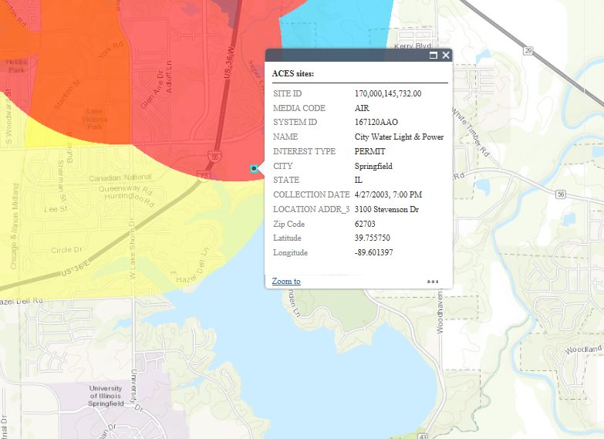

Slide 5
EJ Notification letter
Provides information concerning:
  Company
  Location
  Project
  Type of permit
  Distribution
Provides my contact information for questions or additional information

Slide 6
Distribution List
Local, state, federal elected officials
Groups and individuals signed up to receive
Groups and individuals that previously expressed interest

Slide 7
Chicago Tribune data

Slide 8
Illinois EPA review of data
There are several reasons why we do not send notifications for every permit application
Applications that did not warrant notifications fall into four general categories:
  Remediation sites
  Other land sites/water sites
  Air sites
  Refineries not in an EJ area

Slide 9
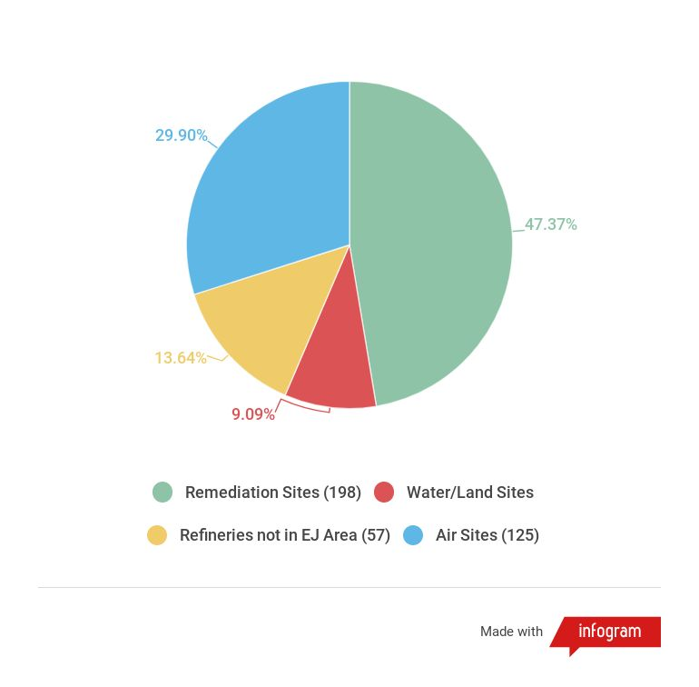
Complete-No Outreach (2015-2016)
Total: 418

Slide 10
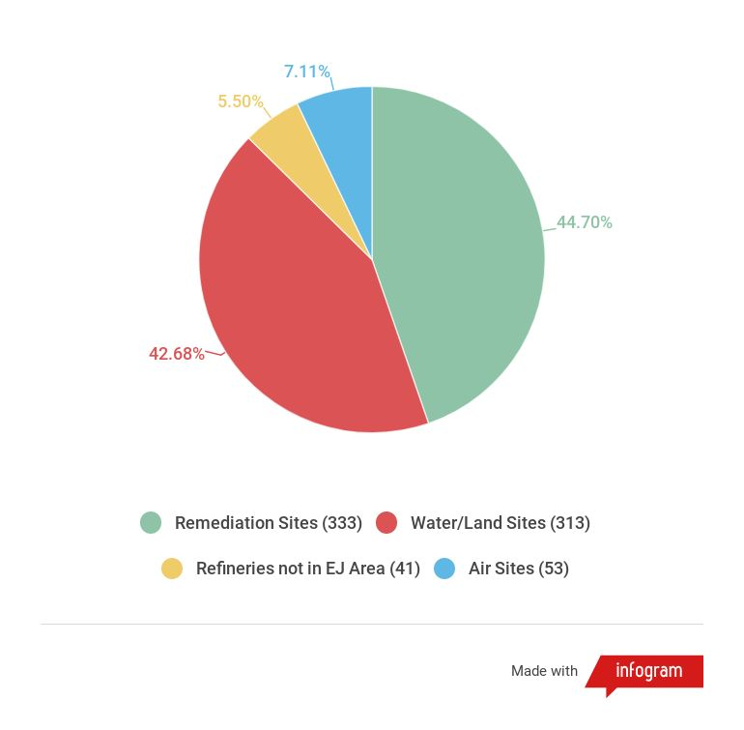
Complete- No Outreach (2017-2018)
Total: 745

Slide 11
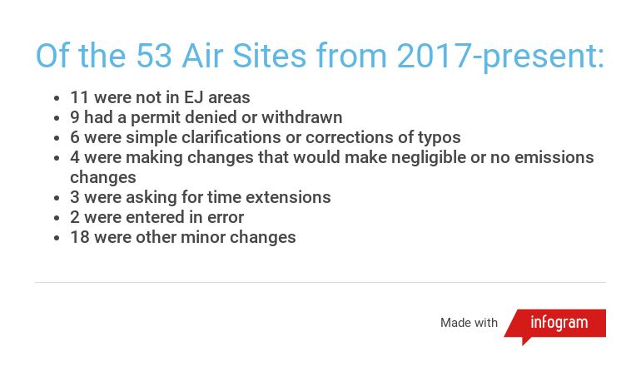
Examples of reasons for not sending notifications

Slide 12
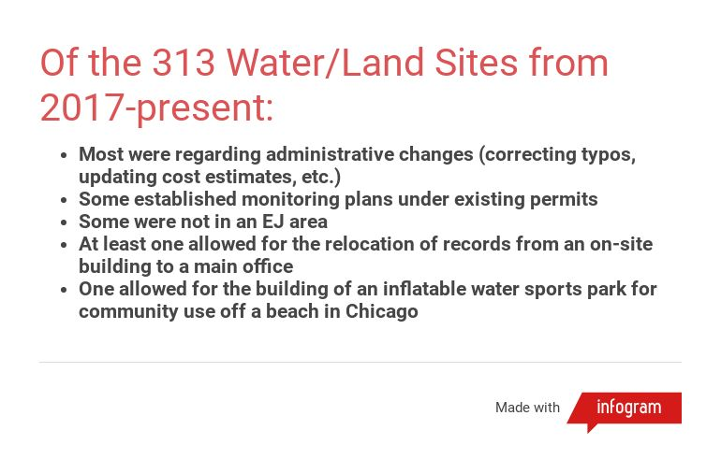
Examples of reasons for not sending notifications

Slide 13
EJ Notification Priorities
Illinois EPA would like to focus EJ outreach
Projects likely to be of concern to areas of EJ concern
Look at how other states have approached issue

Slide 14
Connecticut EJ requirements
An electric generating facility with a capacity greater than 10 megawatts
Sludge or solid waste incinerators or combustors
Sewage treatment plants with a capacity of greater than 50 million gallons per day
Certain waste facilities: intermediate processing center, volume reduction facility or multitown recycling facility with a combined monthly volume in excess of 25 tons
New or expanded landfill, including but not limited to, a landfill that contains ash, construction and demolition debris or solid waste
Medical waste incinerators
A major source of air pollution, as defined by the Clean Air Act

Slide 15
Connecticut EJ requirements
Transfer stations
Biomedical treatment facilities (decontamination, autoclaving or other non-incinerator techniques approved by the commissioner)
RCRA hazardous waste storage or treatment facilities seeking an operating permit
RCRA hazardous waste incinerators or landfills
Non-RCRA hazardous waste storage or treatment facilities
Non-RCRA hazardous waste incinerators or landfills
Hazardous waste transfer facilities

Slide 16
Connecticut EJ Requirements
The Connecticut law applies to permits for new facilities or facility expansions in an EJ community.
Definition of “expansion” per Connecticut
Non-minor permit modifications
  Waste
    Change to any substantive degree the approved design, capacity, waste composition or volume, process or operation of facility
  Air
    Addition of new emission unit or modification to existing emission that increases emissions of any individual air pollutant by 15 tons or more per year or any HAP by 10 tons or more
  Water
    Proposed facility expansion or alteration, production increase or process modification that may result in discharge of any new water, substance or material or increase the quantity or concentration of existing pollutant beyond permit conditions, or may constitute a new source.

Slide 17
Next Steps
Revise EJ Public Participation Policy with input from EJ Commission
Add fillable PDF to Illinois EPA EJ website for notification signup
Develop one page factsheet or summary of EJ notification process
Explore ways to enhance Document Explorer

