Slide 1
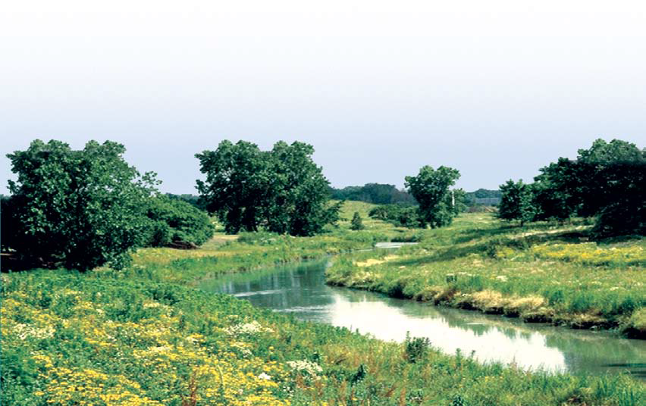
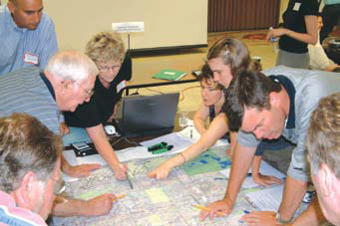
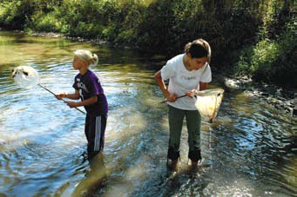

Watershed-based Planning
Scott Ristau
June 3, 2015

Slide 2
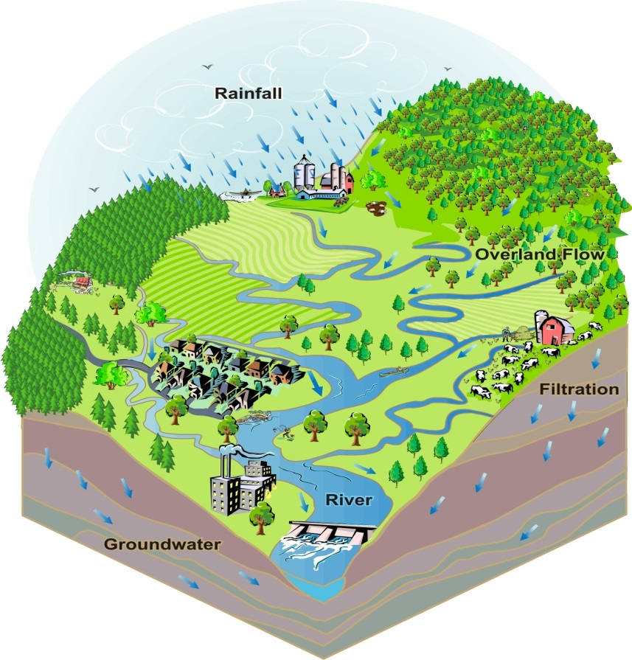
What is a watershed?
A watershed is the land area from which precipitation and resulting surface water runoff drain to a particular stream, river, lake, or wetland.
Watersheds have become the planning and management unit of choice for many water resource issues.

Slide 3
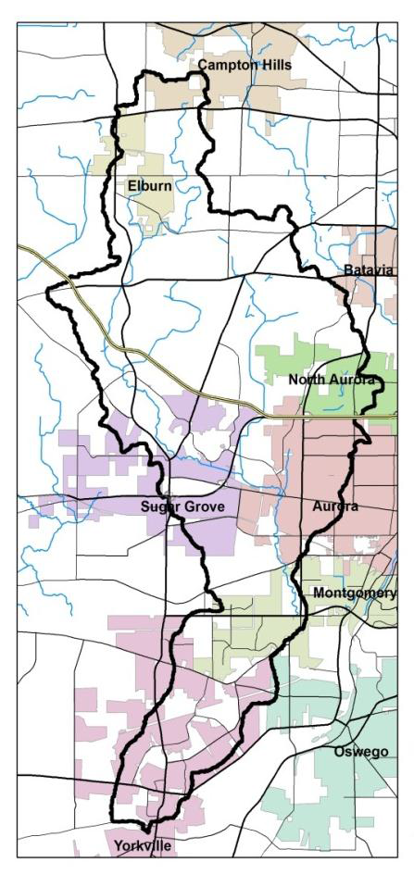
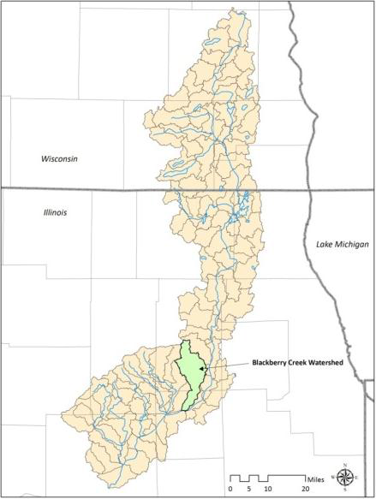
What is a watershed?
Smaller watersheds make up increasingly larger ones as water flows downhill and one stream joins with another.
Based on your objectives and available resources, you should select an appropriate scale (i.e., 12-digit HUC) for writing a watershed-based plan.

Slide 4
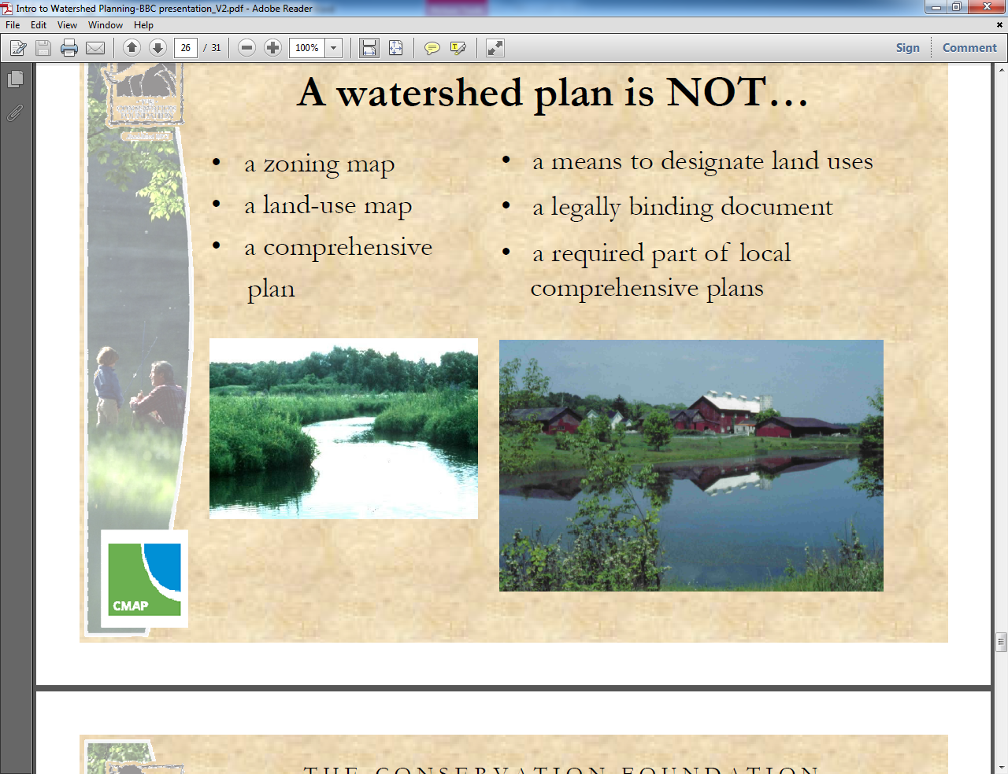
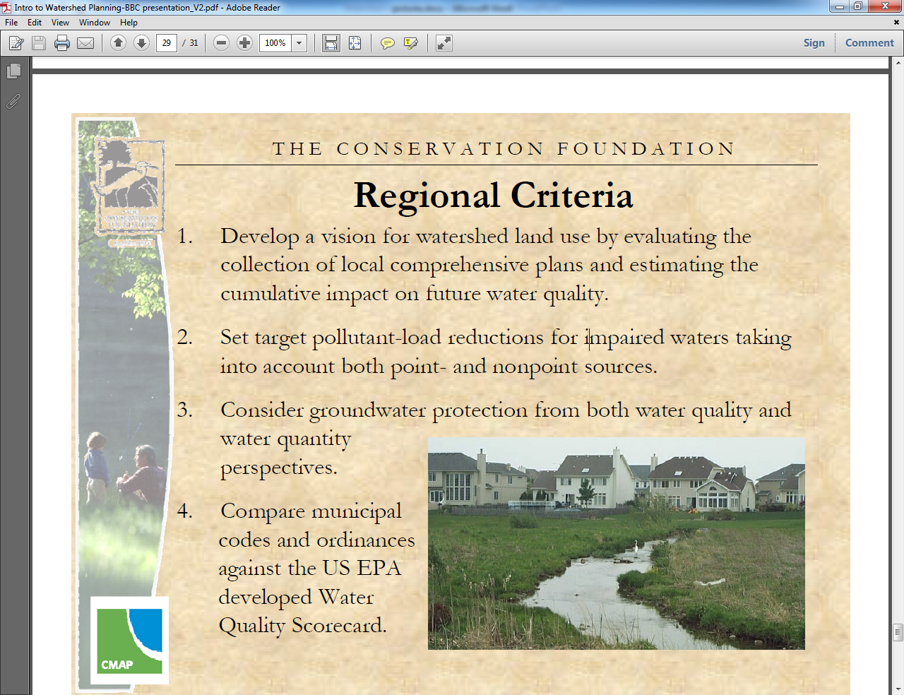
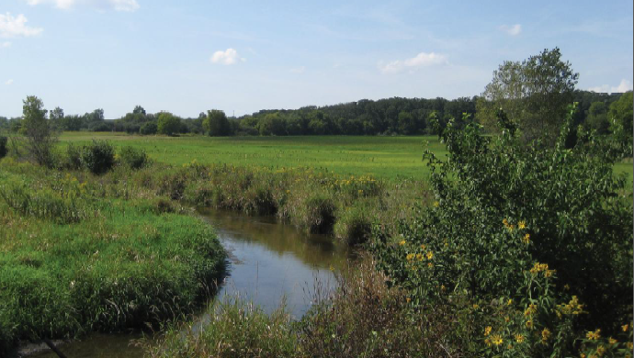
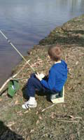
What is a watershed?
Everyone lives in a watershed.
What we do in our watershed impacts our local water quality and the water quality of our downstream neighbors.
The health of a waterbody is a direct reflection of how the land in the watershed is being used and managed.

Slide 5
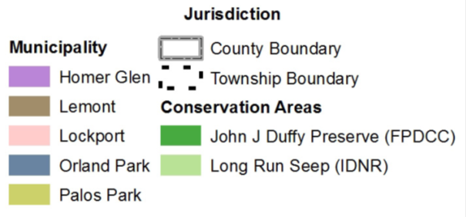
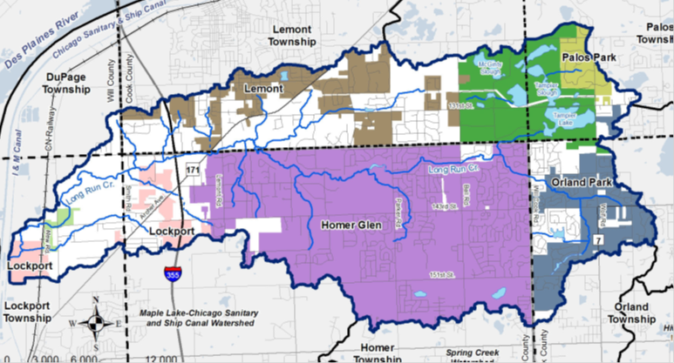
What is a watershed?
Although watersheds cross jurisdictional boundaries they also provide a logical organizational context in which stakeholders can work together to effectively plan and manage land use and other activities that impact both land and water resources.

Slide 6
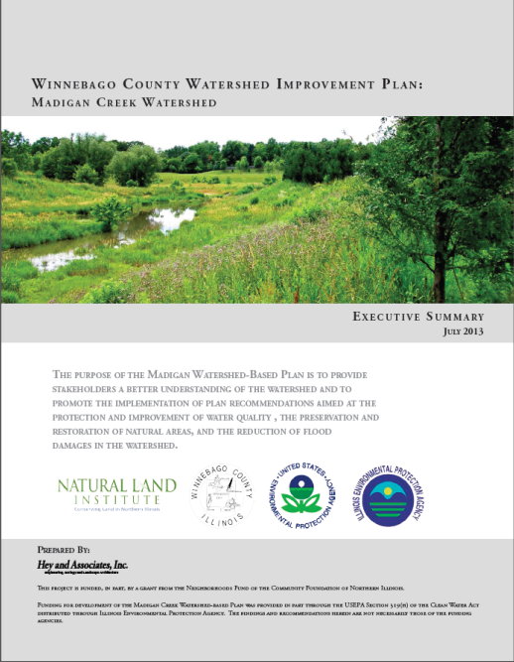
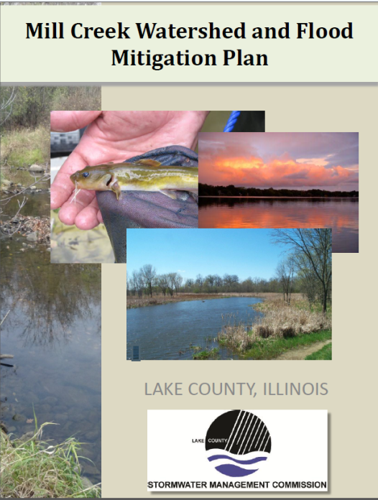
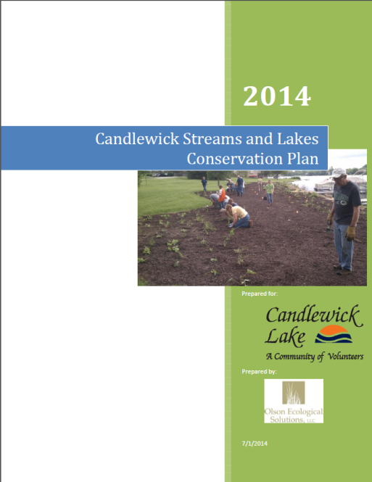
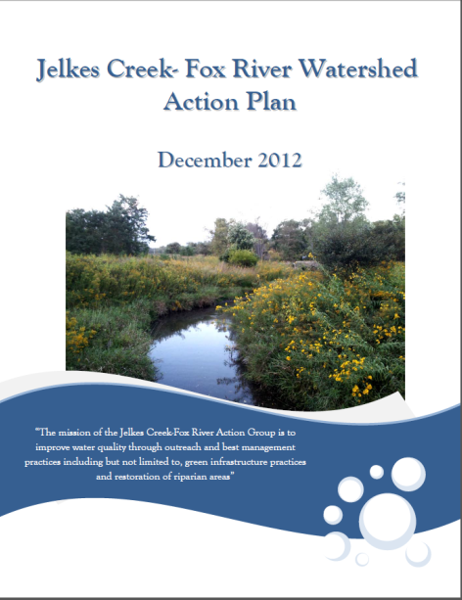
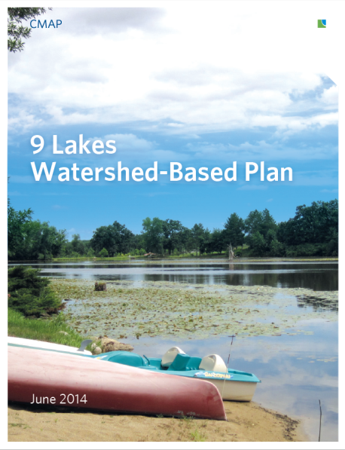
What is a Watershed-based Plan?
A watershed-based plan summarizes the overall condition of the watershed and provides an integrated, holistic framework to effectively and efficiently restore water quality in impaired waters and to protect water quality in other waters adversely affected or threatened by point source and nonpoint source pollution.

Slide 7
What is a Watershed-based Plan?
Point Source Pollution
Section 502 (14) of the Clean Water Act defines point source as: any discernible, confined and discrete conveyance, including but not limited to any pipe, ditch, channel, tunnel, conduit, well, discrete fissure, container, rolling stock, concentrated animal feeding operation, or vessel or other floating craft, from which pollutants are or may be discharged. This term does not include agricultural storm water discharges and return flows from irrigated agriculture.
Permitted Discharges (NPDES)
Domestic Wastewater Treatment Plants
Industrial Wastewater Treatment Plants
Combined Sewer Overflows (CSOs)
Sanitary Sewer Overﬂows (SSOs)
Mine Discharges
Landfills
Municipal Separate Storm Sewer Systems (MS4s)
Concentrated Animal Feeding Operations (CAFOs)

Slide 8
What is a Watershed-based Plan?
Nonpoint Source Pollution
Nonpoint source (NPS) pollution includes pollution caused by rainfall or snowmelt moving over and through the ground and carrying natural and human-made pollutants into lakes, rivers, streams, wetlands, estuaries, other coastal waters and groundwater. Unnatural changes to the shape, flow, or biology of streams and other aquatic systems are also considered NPS pollution.
Urban Runoff
Golf Courses
Construction Site Runoff
Highway, Road/Bridge Runoff
Agricultural Runoff
Crop Production
Animal Feeding Operations
Land Application of Manure
Livestock Grazing
Resource Extraction Activities
Streambank Erosion
Streambed Erosion
Stream Channelization
Dams or Impoundments
Drainage/Filling/Loss of Wetlands
Loss of Riparian Habitat
Failing Septic Systems
Atmospheric Deposition

Slide 9
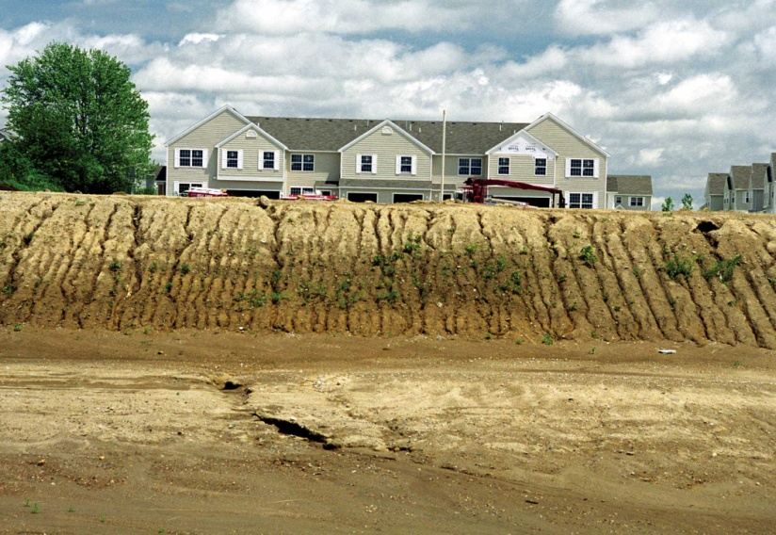
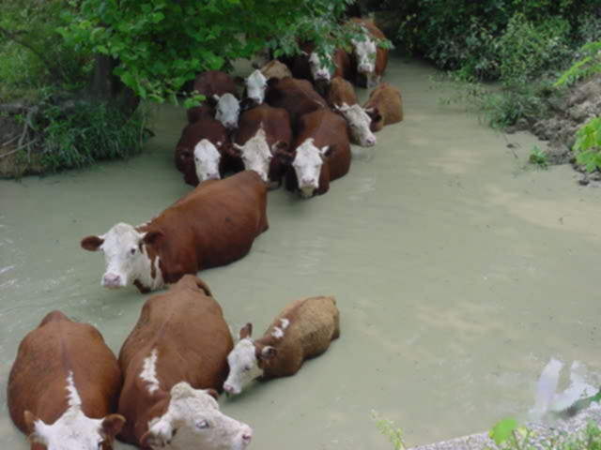
What is a Watershed-based Plan?
Runoff in urban areas may contain sediment, fertilizers, pesticides, motor oil, road salt, household chemicals, and bacteria.
Runoff in rural areas may contain sediment, nitrogen, phosphorus, pesticides, and pathogens.

Slide 10
What is a Watershed-based Plan?
“Due to the complex and diffuse nature of nonpoint source pollution, the substantial costs to address it, and frequent reliance on voluntary action by individual landowners, successfully addressing nonpoint source pollution to achieve water quality standards often requires years of support from a coalition of stakeholders, programs, and funding sources.
Watershed planning helps address water quality problems in a holistic manner by fully assessing the potential contributing causes and sources of pollution, then prioritizing restoration and protection strategies to address these problems.” -Handbook for Developing Watershed Plans to Restore and Protect Our Waters

Slide 11
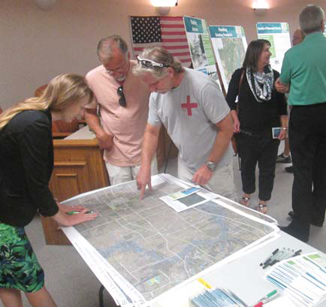
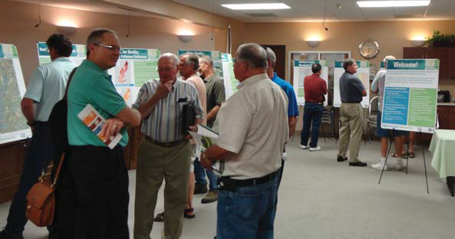
What is a Watershed-based Plan?
Watershed-based planning is a collaborative, stakeholder supported approach to improving and protecting water resources.

Slide 12

What is a Watershed-based Plan?
Stakeholders are people who live, work, or recreate in the watershed.
Stakeholders can include representatives from local governments, conservation and park districts, nonprofit organizations, businesses, local landowners, homeowners associations, and many others.
Stakeholder involvement is critical at every stage of plan development and implementation, and it will increase the probability of long-term success.

Slide 13
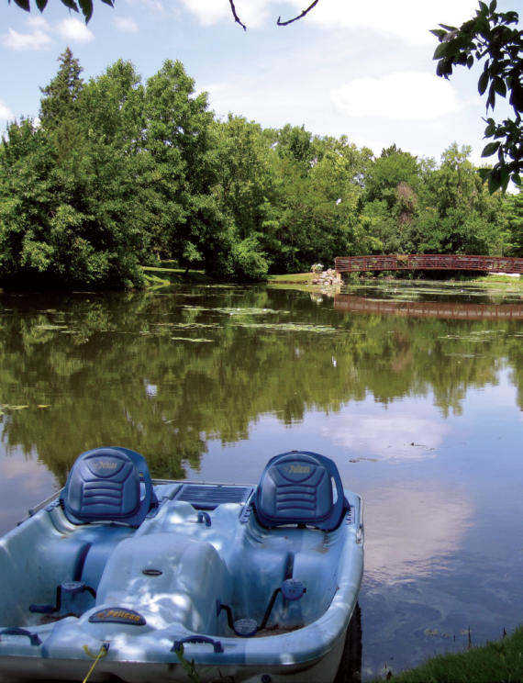
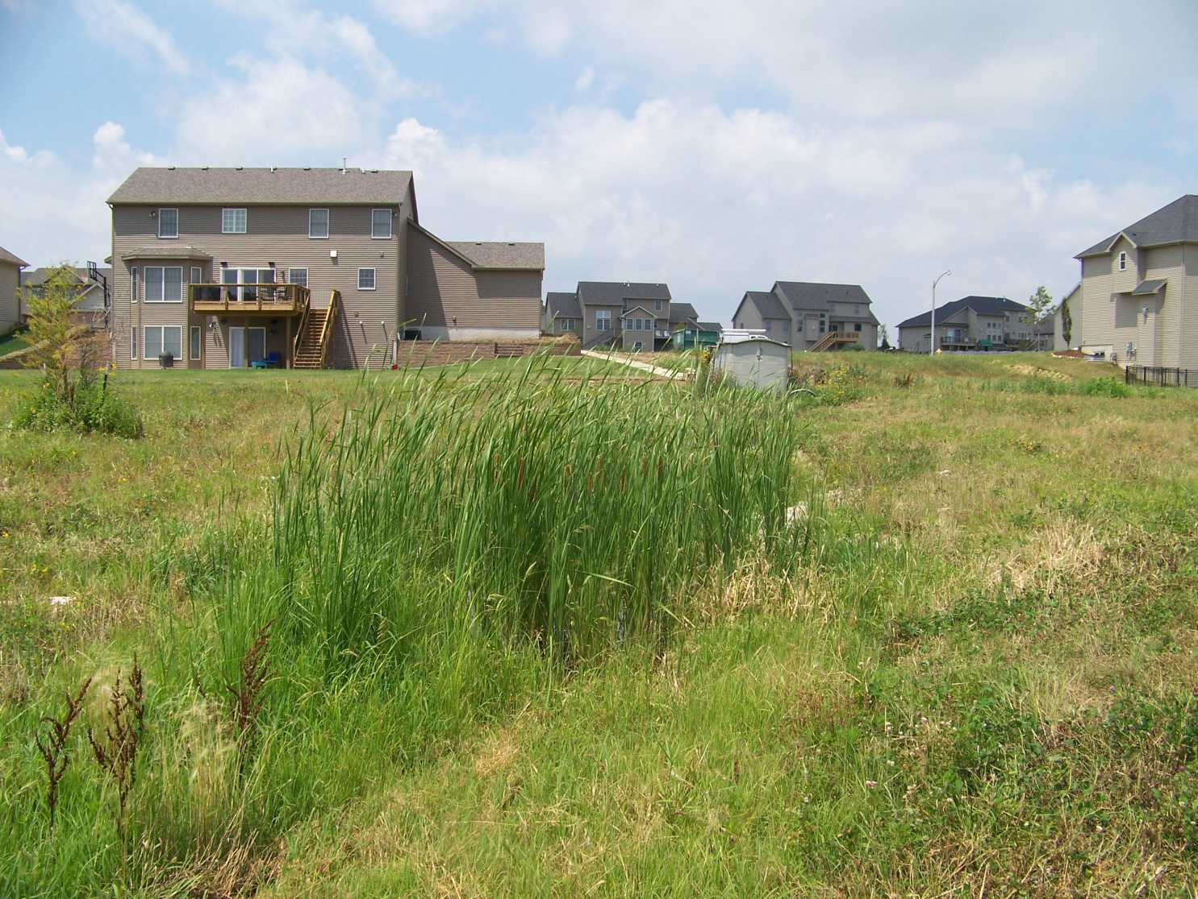
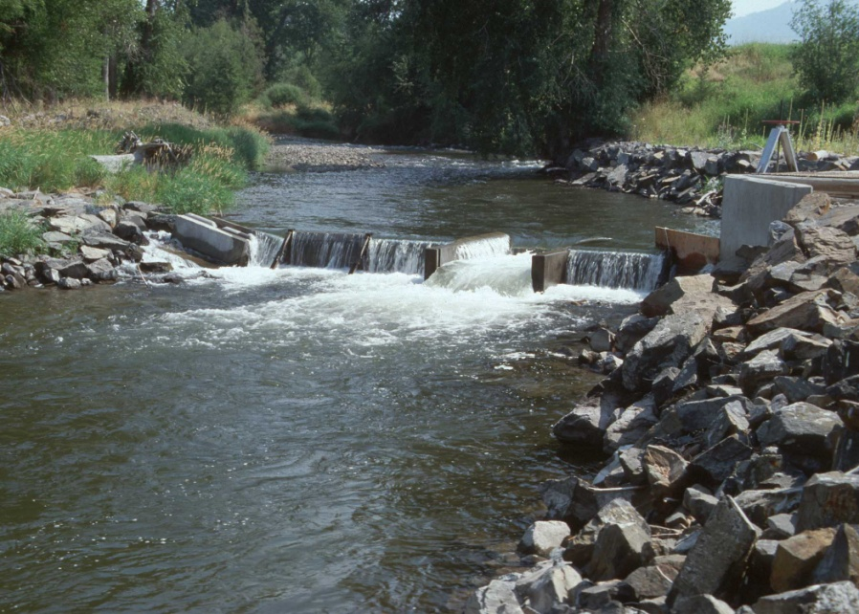
Why Write a Watershed-based Plan?
Clean and abundant water, healthy lakes and streams, and safety from flooding are important for residents, agricultural producers, businesses, and the economic and environmental health of our communities.

Slide 14

Why Write a Watershed-based Plan?
A watershed-based plan can help:
Identify problems, define goals and objectives, and establish priorities.
Educate and involve stakeholders.
Facilitate partnerships and collaboration among stakeholders.
Guide regulation and the implementation of management practices.
Support local zoning decisions, development standards, and transportation planning.
Reduce the impacts of pollution on surface water and groundwater.
Restore lakes, streams, and wetlands to a healthy condition.

Slide 15
Why Write a Watershed-based Plan?
A watershed-based plan can help:
Conserve prime farmland.
Prevent and reduce flood damage.
Protect and enhance natural resources and recreational opportunities.
Achieve Total Maximum Daily Loads (TMDLs).
Support sustainable communities and economic growth.
Target limited financial resources.
Identify and enhance funding opportunities (i.e., 319, ICWI).

Slide 16

Why Write a Watershed-based Plan?
NPS Pollution Control Financial Assistance Program
Under Section 319(h) of the Clean Water Act:
Illinois EPA makes federal grant funds available to implement nonpoint source (NPS) pollution control projects.
Grant guidelines now require that most of the available grant funds go toward restoring impaired waters through the implementation of watershed-based plans that meet the nine minimum elements.

Slide 17
What’s in a Watershed-based Plan?
Nine Minimum Elements of a Watershed-based Plan
Identify causes and sources of water pollution and estimate existing pollutant loads.
Set water quality goals and load reduction targets to achieve those goals, and estimate load reductions expected from recommended management measures.
Describe the management measures needed to achieve load reduction targets.
Describe the technical and financial assistance (amount, costs, and sources) and relevant authorities needed to implement the plan.
Describe an information and education component to enhance public understanding and to encourage implementation of the plan.
Provide a schedule for implementing the management measures identified in the plan.
Identify interim, measurable milestones for determining whether management measures are being implemented on schedule.
Identify interim benchmarks to measure progress in meeting water quality goals and load reduction targets.
Describe a monitoring component.

Slide 18
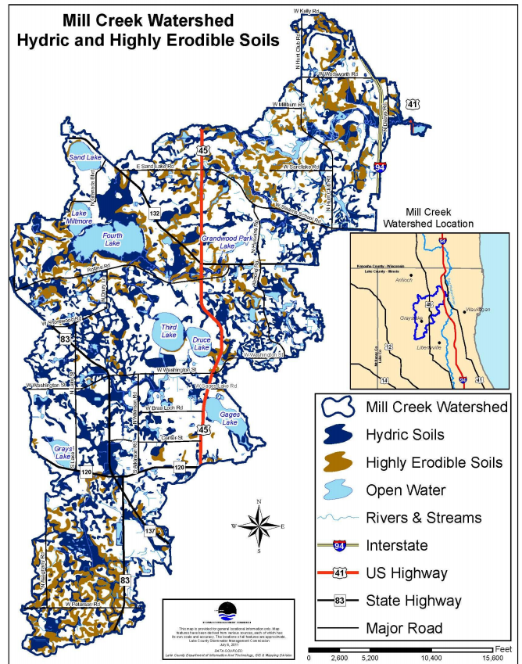
What’s in a Watershed-based Plan?
Element 1: Identify causes and sources of water pollution and estimate existing pollutant loads.
Compile a watershed resource inventory to document the existing conditions in the watershed and its sub-watersheds, such as the:
Geographic boundaries, location, topography, and size of the watershed and its sub-watersheds.
Location, size, and spatial relationship of waterbodies.
Soil types, hydric soils, soil erodibility, and hydrologic soil groups.
Geology and climate.
Existing wetland areas and historic wetland loss.

Slide 19
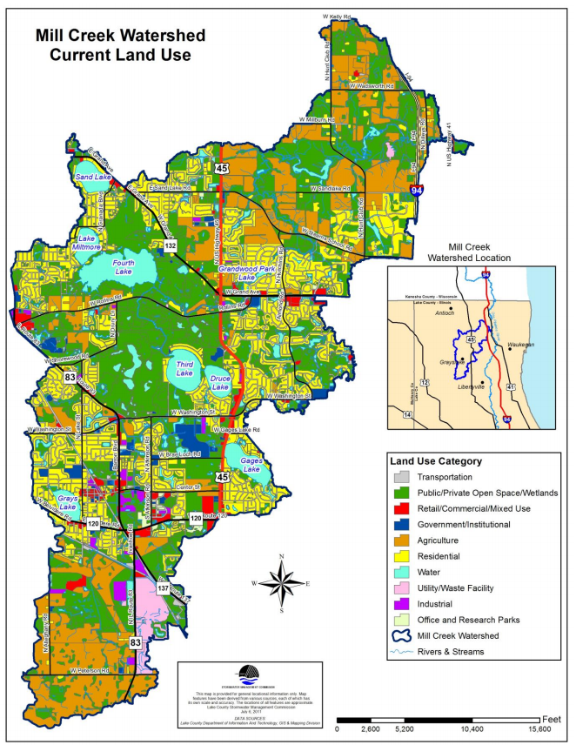
What’s in a Watershed-based Plan?
Element 1 – continued.
Units of government and their associated jurisdictions, roles, and responsibilities.
Population, population change, growth forecasts, and other demographic data.
Existing and predicted land use / land cover.
Existing and predicted future percent imperviousness.
High quality natural resources needing protection.
Type, location, and condition of detention basins.

Slide 20
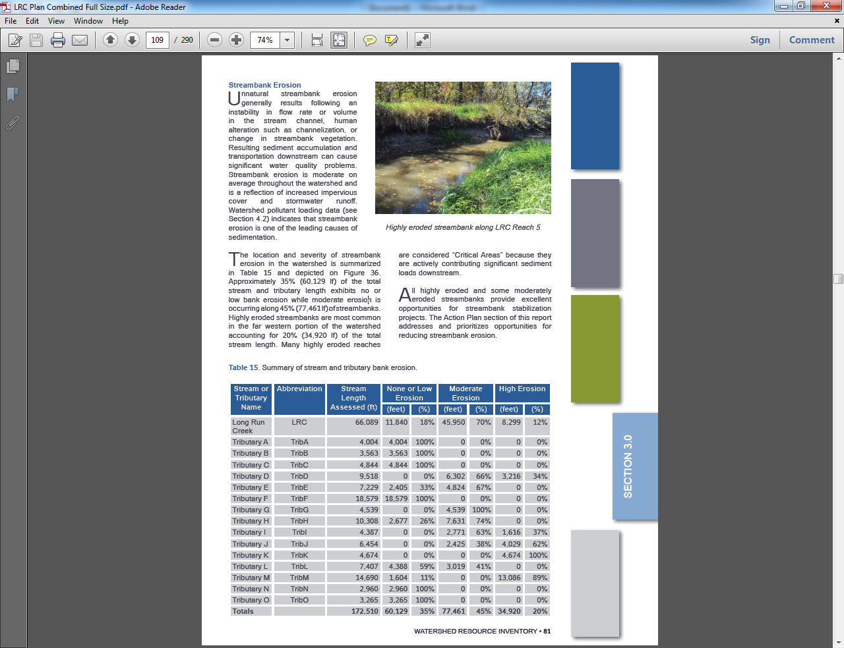
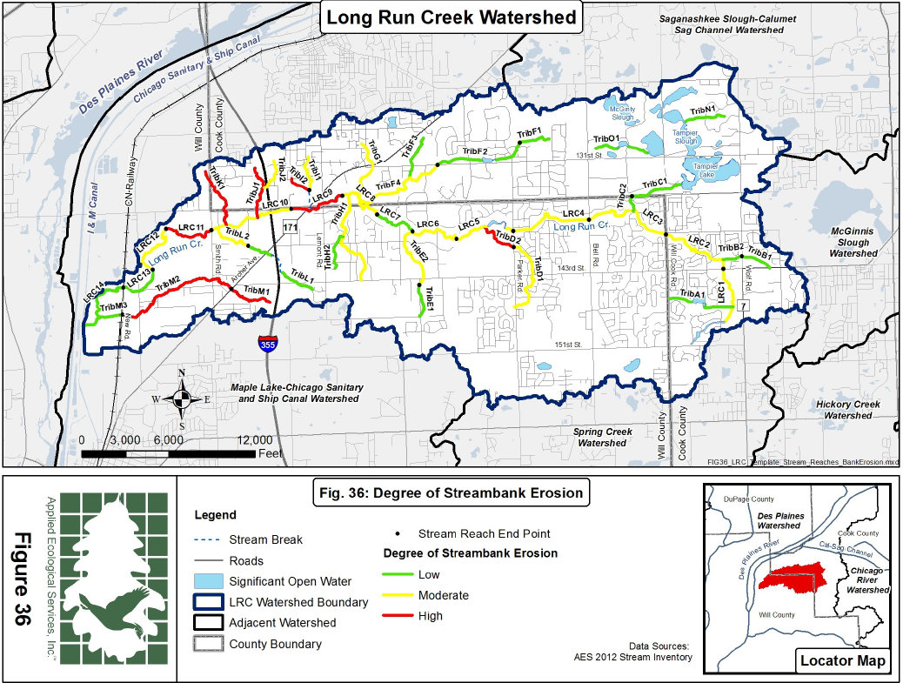
What’s in a Watershed-based Plan?
Element 1– continued.
Degree of streambed, streambank, and shoreline erosion.

Slide 21
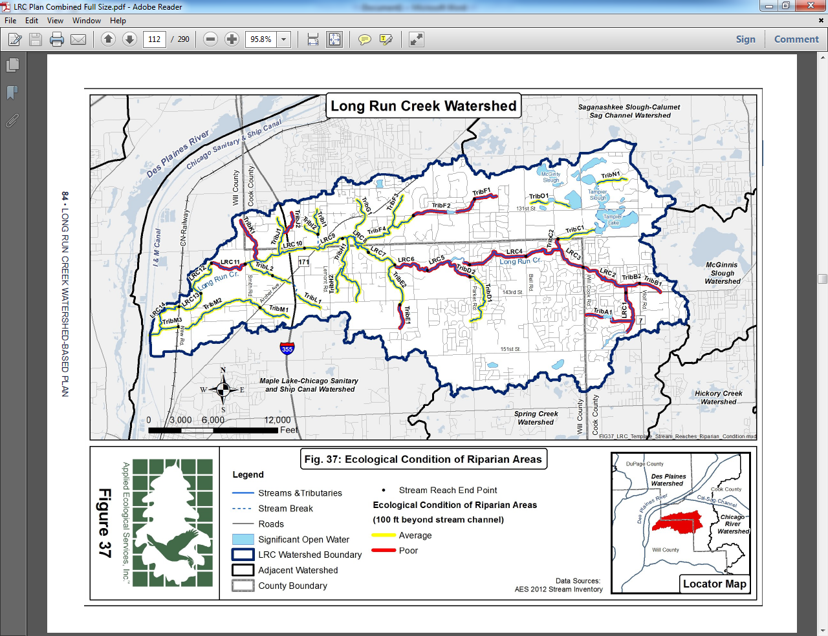
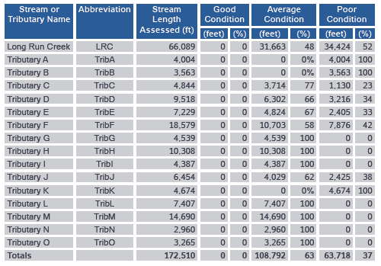
What’s in a Watershed-based Plan?
Element 1– continued.
Condition of riparian and shoreline buffer areas.

Slide 22
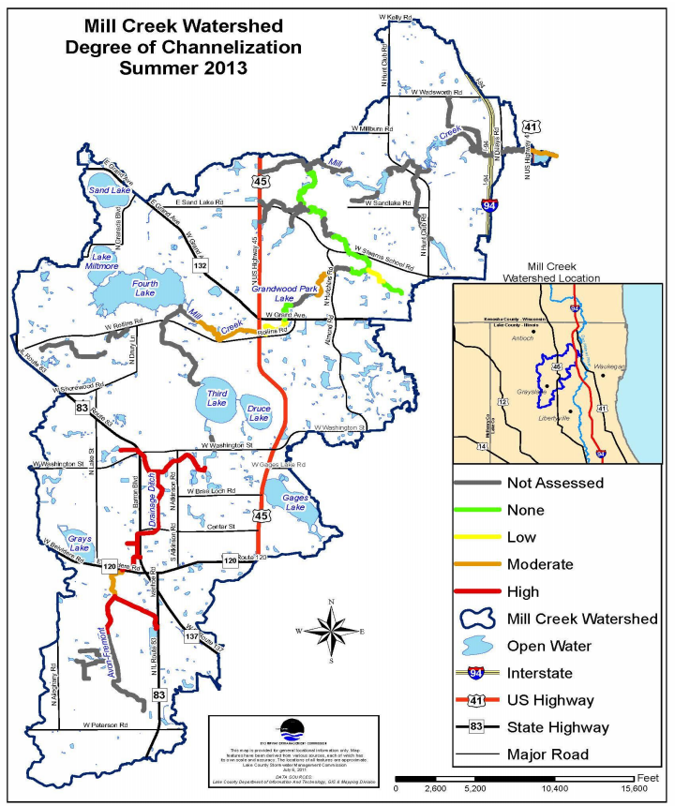
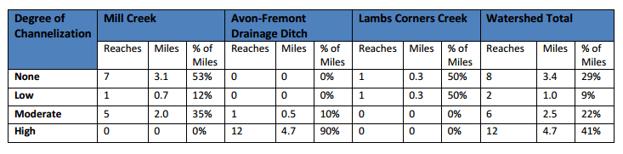
What’s in a Watershed-based Plan?
Element 1– continued.
Degree of stream channelization and wetland loss.

Slide 23
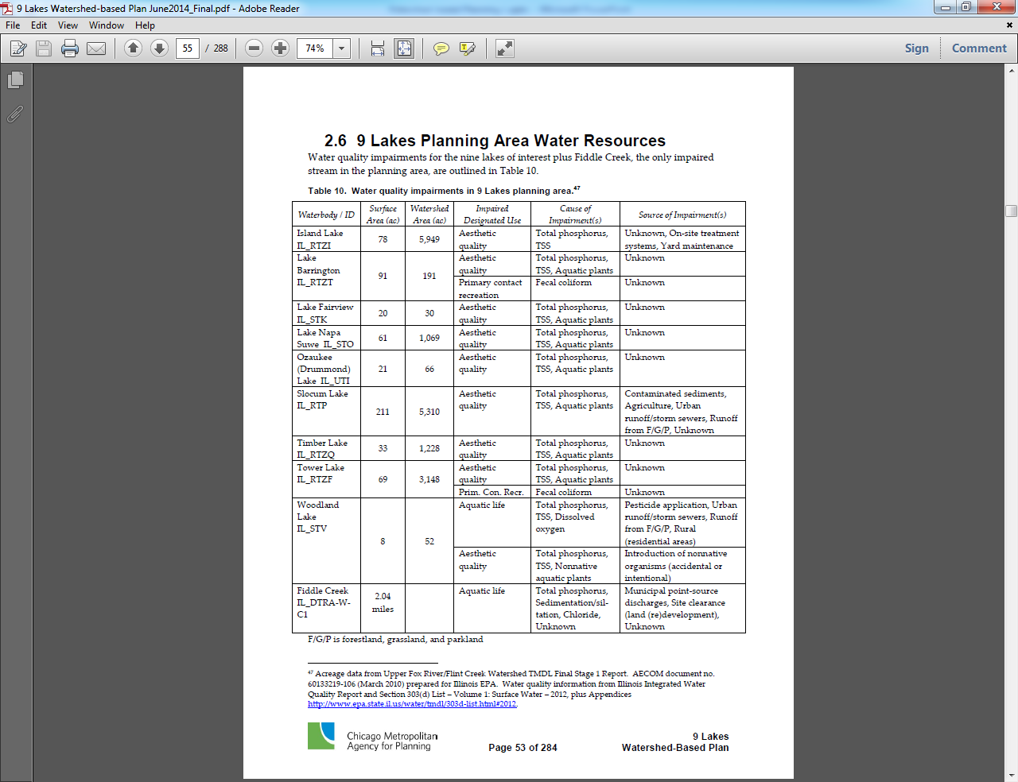
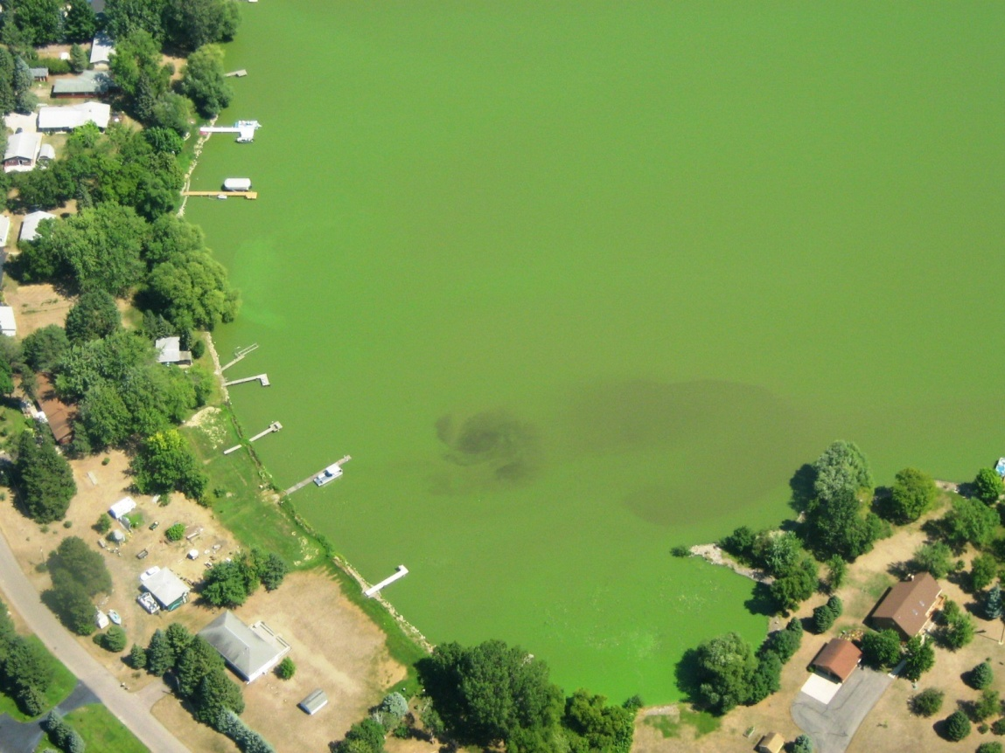
What’s in a Watershed-based Plan?
Element 1 – continued.
Designated use support and causes and sources of impairment for individual waterbodies as reported in the most recent Illinois Integrated Water Quality Report and Section 303d List.

Slide 24
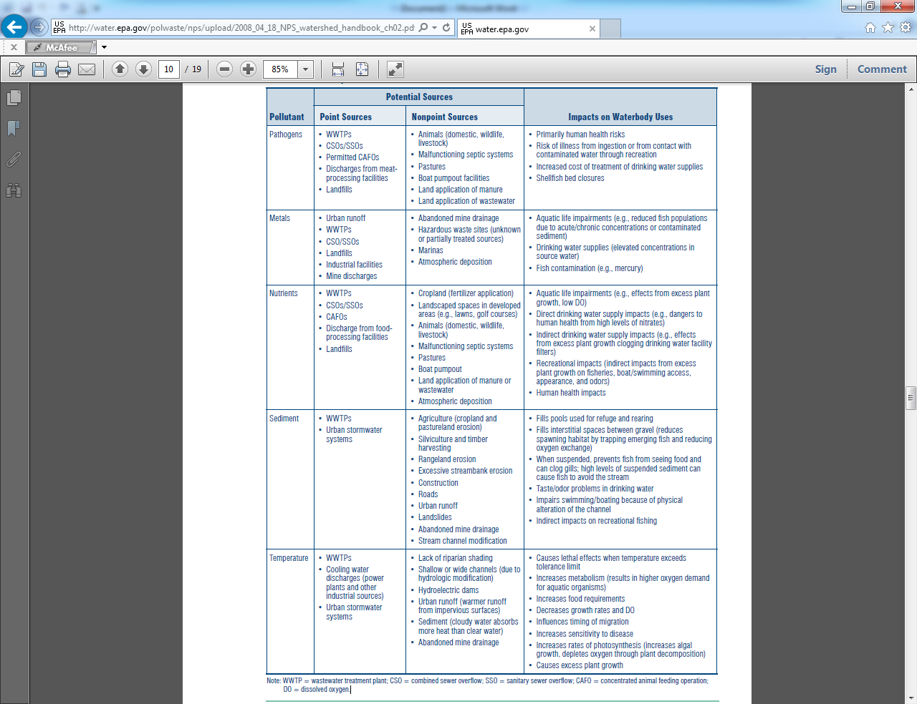
What’s in a Watershed-based Plan?
Element 1 – continued.
Include both existing and potential causes (pollutants) and sources.
Focuses on nonpoint sources but can also include point sources.

Slide 25
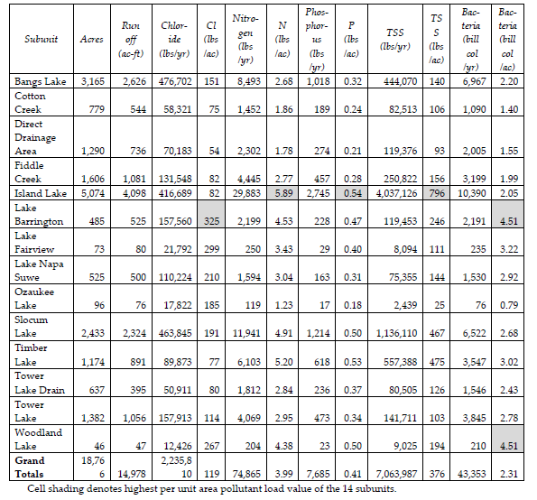
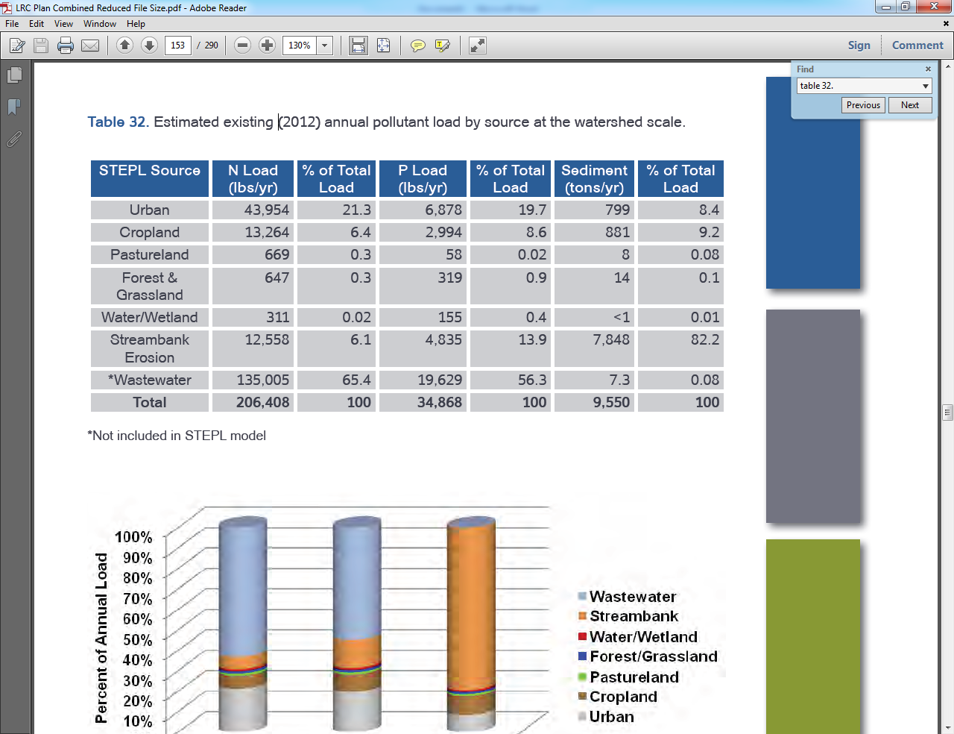
What’s in a Watershed-based Plan?
Element 1 – continued.
Identify the existing annual load for each pollutant of concern.

Slide 26
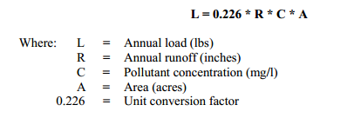
What’s in a Watershed-based Plan?
Element 1 – continued.
Models can be used to determine existing pollutant loads, pollutant load reduction targets, and BMP load reductions.
For example:
SWAMM (Spatial Watershed Assessment and Management Model)
STEPL (Spreadsheet Tool for Estimation of Pollutant Load)
Region 5 Load Estimation Spreadsheet Model (Microsoft Excel)
http://it.tetratech-ffx.com/steplweb/default.htm
The Simple Method.

Slide 27

What’s in a Watershed-based Plan?
Element 1 – continued.
A combination of models may be necessary.
For example, if STEPL can’t be used to analyze pollutant loads from streambank erosion, you may need to use some other method (i.e., Region 5 model) to estimate the pollutant loads from streambank erosion and integrate that information with the STEPL results for the other sources.

Slide 28
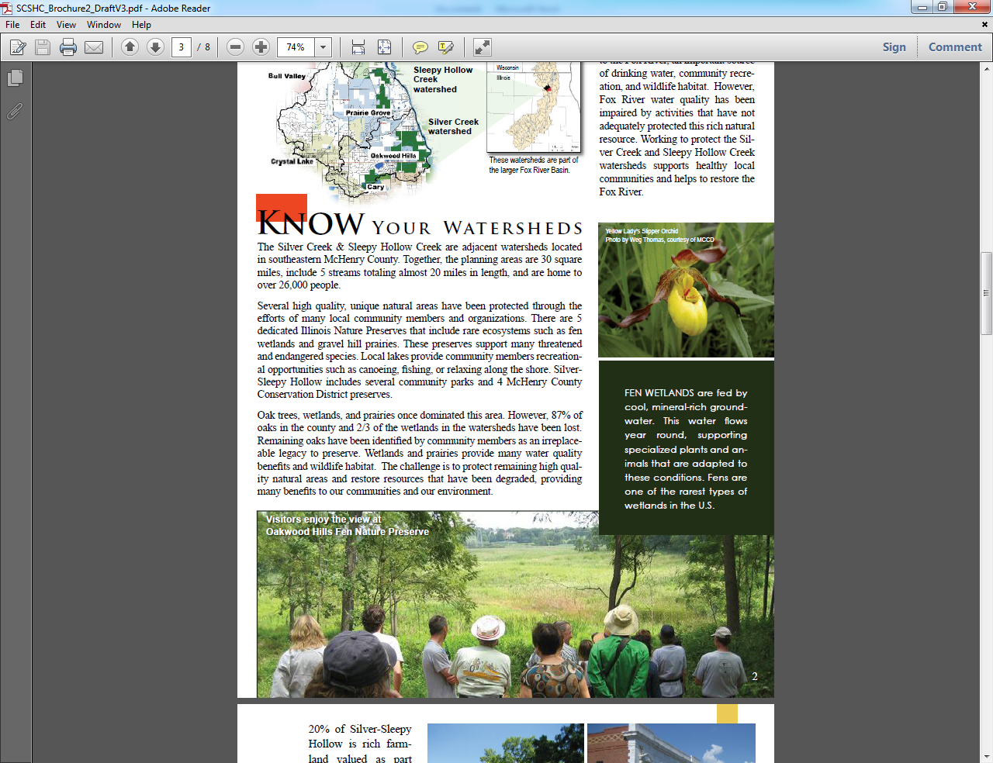
What’s in a Watershed-based Plan?
Element 2 – Set water quality goals.
Water quality goals could include:
Achieving water quality standards for specific pollutants.
Achieving total maximum daily loads (TMDLs) for specific pollutants.
Achieving water quality benchmarks (i.e., 40 milligrams/liter of TSS) for specific pollutants for which there is no water quality standard. Such benchmarks can be derived from the average concentrations of that pollutant found in comparable streams that are meeting full use support in the same or similar watersheds.

Slide 29

What’s in a Watershed-based Plan?
Element 2 – continued. Set load reduction targets.
For each pollutant of concern, identify load reduction targets designed to achieve the water quality goals set for the watershed.
TSS Load Reduction Target (lbs/year) | Phosphorus Load Reduction Target (lbs/year) | Nitrogen Load Reduction Target (lbs/year) | Total Dissolved Solids Load Reduction Target (lbs/year) | BOD Load Reduction Target (lbs/year) | COD Load Reduction Target (lbs/year) | Chloride Load Reduction Target (tons/year)
1,430,843 | 1,595 | 13,000 | 3,236,832 | 50,666 | 550,900 | 633

Slide 30
What’s in a Watershed-based Plan?
Element 3 – Describe the management measures needed to achieve load reduction targets.
For the watershed as a whole, identify best management practices (BMPs) recommended to achieve water quality and natural resource objectives.
Identify the BMP type, combined amount (i.e., number, acres, feet), cost, and estimated pollutant load reduction.
BMP Category | BMP Type | Quantity | Unit | COST | Sediment Load Reduction (tons/year) | Phosphorus Load Reduction (lbs/year) | Nitrogen Load Reduction (lbs/year)
OTHER2 | Buffer Zone Enhancement / Installation | 7.4 | acre | 3716 | 223 | 643 | 6667
AGRICULTURE | Conservation Cover | 2491 | acre |  | 4735 | 10577 | 193127
AGRICULTURE | Cover and Green Manure Crop | 23144 | acre | 1620047 | 6336 | 11700 | 206446
AGRICULTURE | Filter Strip | 24 | acre | 11974 | 1856 | 3430 | 27868
AGRICULTURE | Grassed Waterway | 30 | acre | 98237 | 1490 | 2391 | 26685
AGRICULTURE | Infiltration Trench | 215 | number | 1246320 | 1260.31 | 2871.4 | 58156
AGRICULTURE | Level Spreader | 146 | number | 582044 | 3002 | 6340 | 44924
AGRICULTURE | Nutrient Management | 23242 | acre | 386984 | 0 | 14774 | 44901
AGRICULTURE | Structure for Water Control | 179 | number | 1458981 | 0 | 35 | 45402
AGRICULTURE | Water and Sediment Control Basin |  | feet | 7500 | 21 | 40 | 109
HYDROLOGIC | Stream Channel Restoration | 187988 | feet | 13080208 | 12.03 | 40 | 879
HYDROLOGIC | Wetland Restoration | 1106 | acre | 11616954 | 5883 | 9735 | 157941
 |  |  | Totals | 30112965 | 24818.34 | 62576.4 | 813105

Slide 31
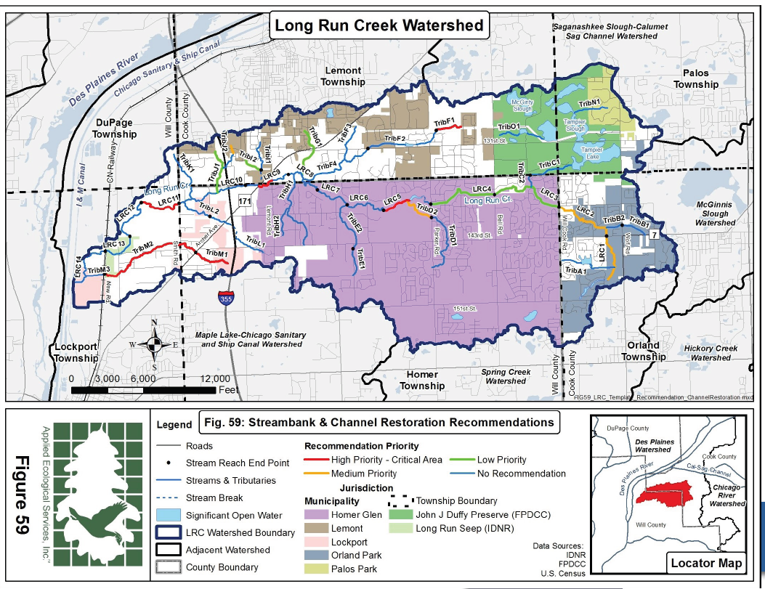
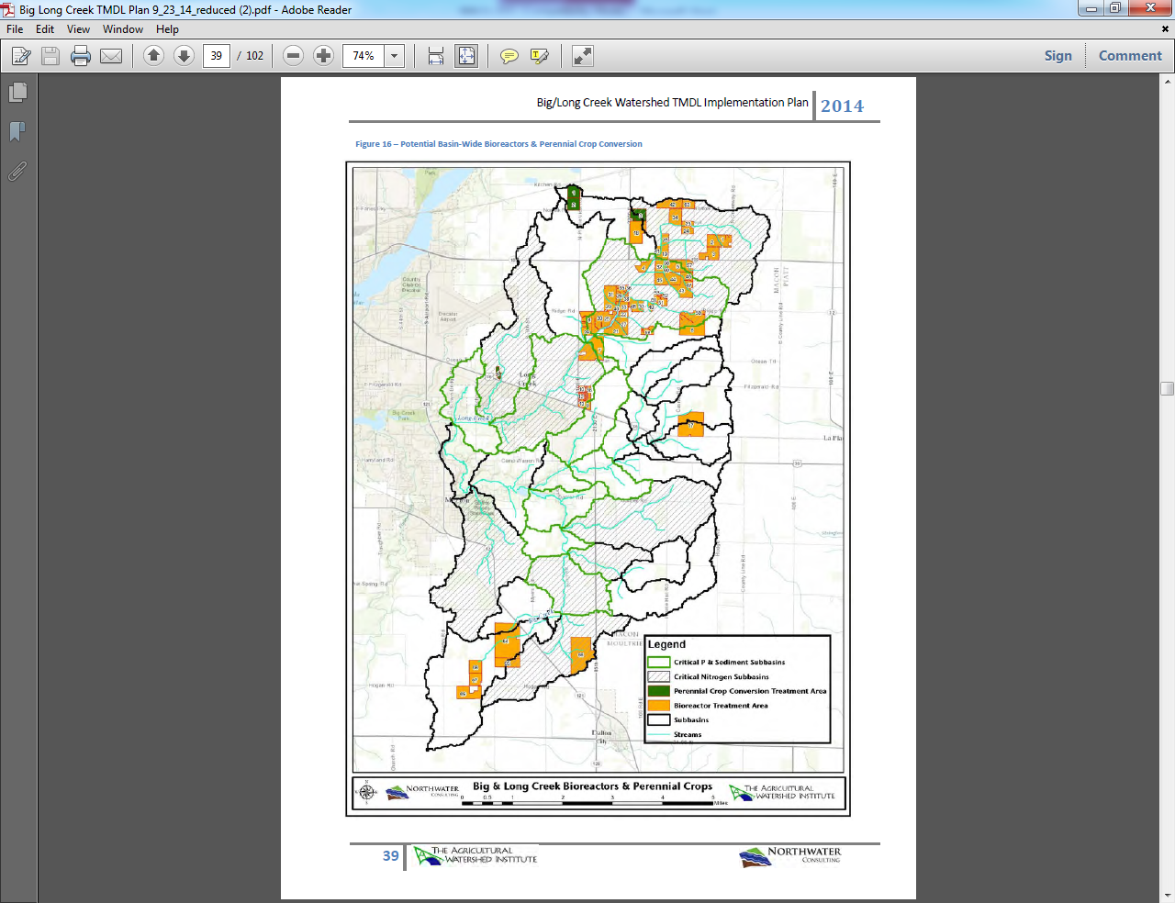
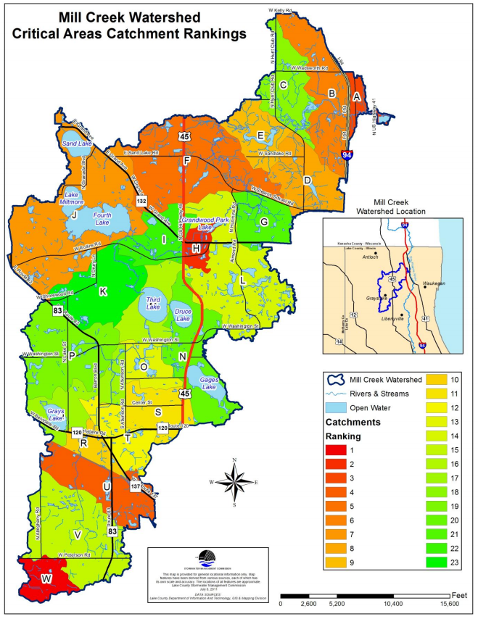
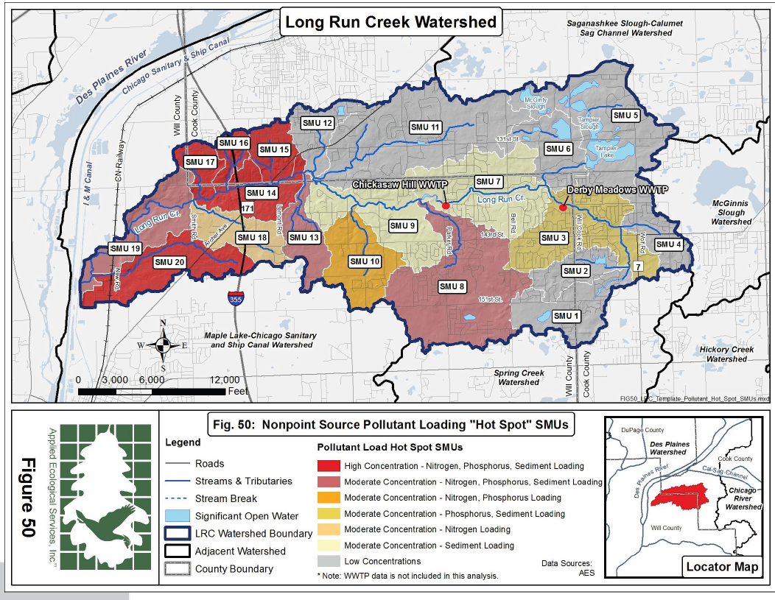
What’s in a Watershed-based Plan?
Element 3 – continued.
Identify priority areas and practices.

Slide 32
What’s in a Watershed-based Plan?
Element 3 – continued.
In addition to the watershed-wide BMP recommendations, identify a sampling of some potential site-specific BMP recommendations.
Identify the site-specific BMP type, size (i.e., number, acres, feet), cost, estimated pollutant load reduction, latitude and longitude, priority, and responsible entity.
Map ID # | Landowner Name | BMP Name | Number | Acres | Feet | Nitrogen Load Reduction (lbs/year) | Phosphorus Load Reduction (lbs/year) | Total Suspended Solids Load Reduction (lbs/year) | Sediment Load Reduction (tons/year) | Latitude | Longitude | Total Cost($)
1 | Chicago Horticultural Society | Stream bank and Shoreline Protection | - | - | 5,187 | 116 | 58 | - | 68 | 42.14820 | -87.79390 | 1,017,125
2 | Deerfield High School | Wetland Restoration | - | 1.40 | - | - | - |  | - | 42.18667 | -87.84780 | 85,207
3 | City of Highland Park | Wetland Restoration | - | 1.07 | - | 35 | 5 | - | - | 42.18987 | -87.82193 | 24,150
4 | Amhurst Lake Business Park Owners Assoc | Stream bank and Shoreline Protection | - | - | 2,000 | 112 | 56 | - | 66 | 42.32597 | -87.88817 | 72,764
5 | Abbott Laboratories | Urban Storm water Wetlands | 1 | - | - | 849 | 203 | 295,446 | - | 42.28376 | -87.89716 | 26,100
6 | Village of Glenview | Green Roof | - | 0.10 | - |  |  |  |  | 42.10154 | -87.81895 | 112,471
7 | Village of Glenview | Porous Pavement | - | 0.28 | - | 3 |  | 570 |  | 42.10139 | -87.81882 | 38,470
8 | Deerfield High School | Stream bank and Shoreline Protection | - | - | 430 | 180 | 90 |  | 90 | 42.18616 | -87.84792 | 70,893
9 | Cook County Forest Preserve District | Grade Stabilization Structure | 4 | - | - | 80 | 40 |  | 47 | 42.06613 | -87.77287 | 10,000
10 | Northfield Park District | Urban Filter Strip | - | 0.37 | - | 5 | 3 | 2,826 |  | 42.10313 | -87.77694 | 102,760
11 | Village of Glenview | Urban Storm water Wetlands | 1 | - | - | 60 | 14 | 12,362 |  | 42.07804 | -87.83502 | 28,805
12 | City of Highland Park | Grass-Lined Channels | - | 0.08 | - | 2 | 1 | 2,178 |  | 42.19800 | -87.82560 | 18,116
13 | Park District of Highland Park | Cistern | 1 | - | - |  |  |  |  | 42.17630 | -87.80911 | 7,484
14 | Park District of Highland Park | Rain Garden | 1 | - | - |  |  | 45 |  | 42.17625 | -87.80904 | 3,000

Slide 33
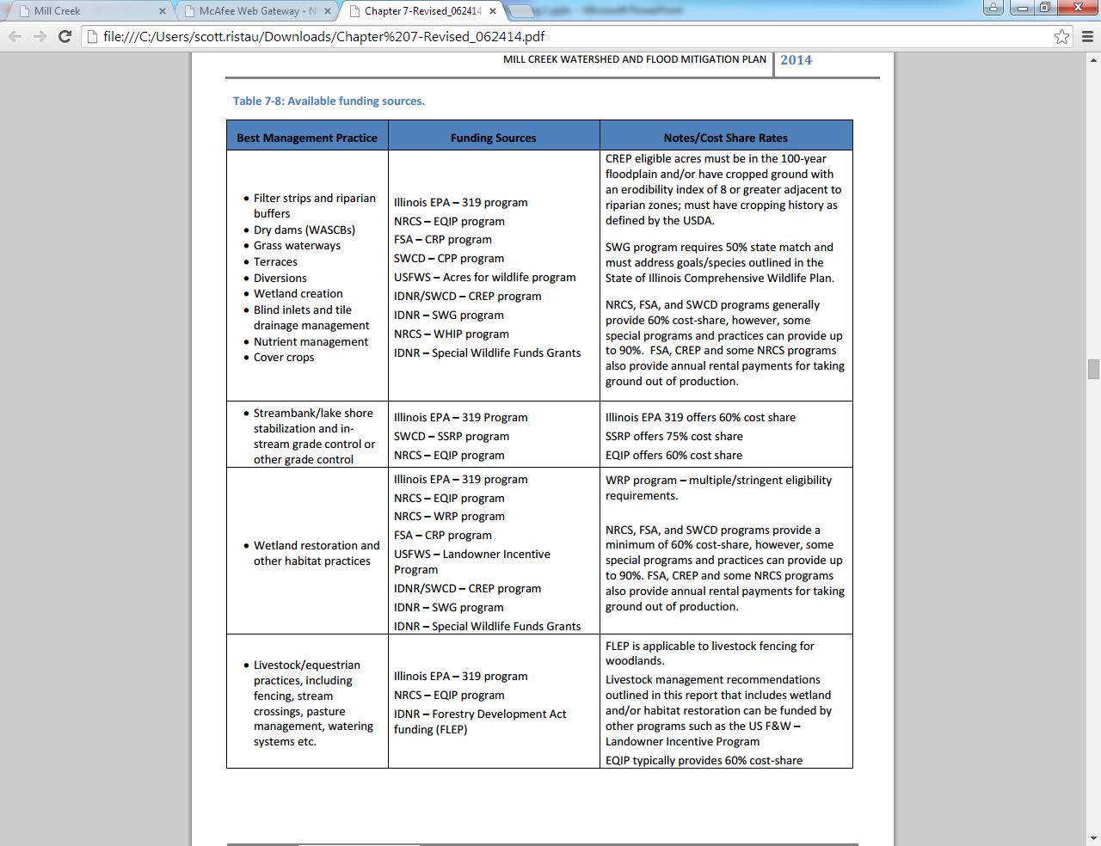
What’s in a Watershed-based Plan?
Element 4 – Describe the technical and financial assistance and relevant authorities needed to implement the plan.

Slide 34
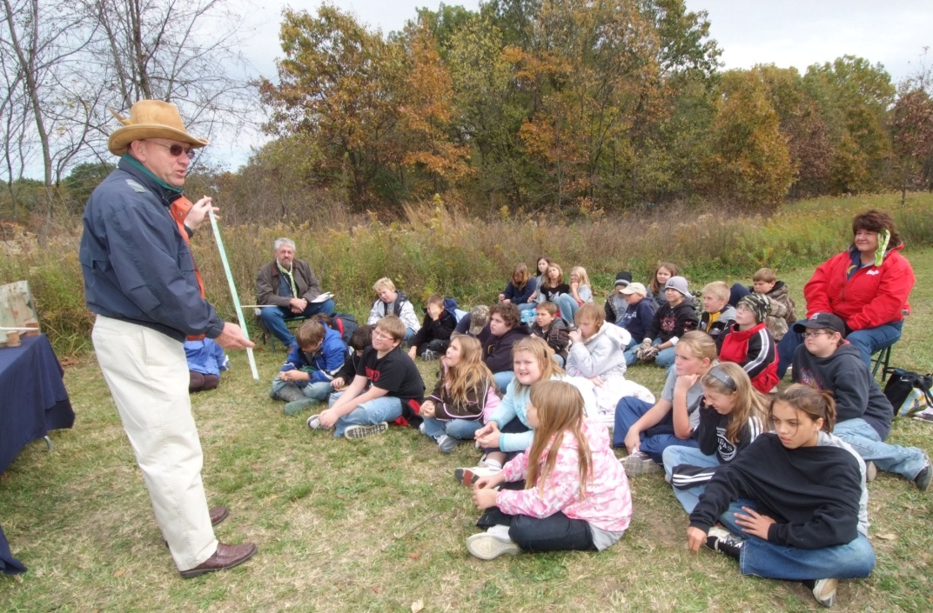
What’s in a Watershed-based Plan?
Element 5 – Information and education component to enhance public understanding and encourage plan implementation.
The information and education component should identify:
Goals and objectives.
Target audiences.
Programs, tools, materials, actions, campaigns.
Delivery mechanisms.
Priority/schedule.
Lead and supporting organizations.
Expected outcome/behavior change.
Estimated cost.
Indicators of success.

Slide 35
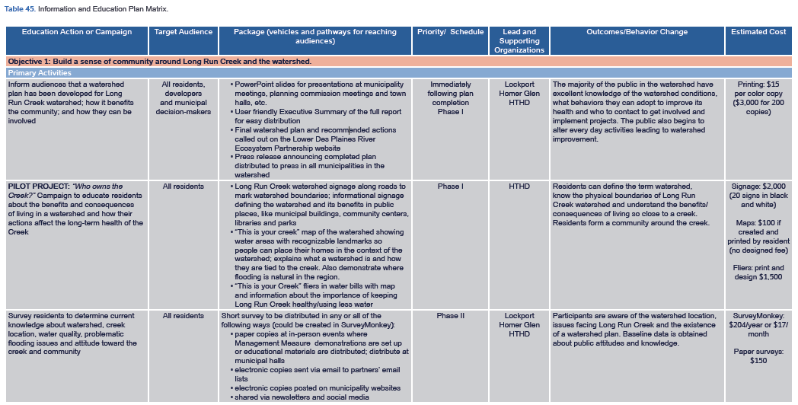
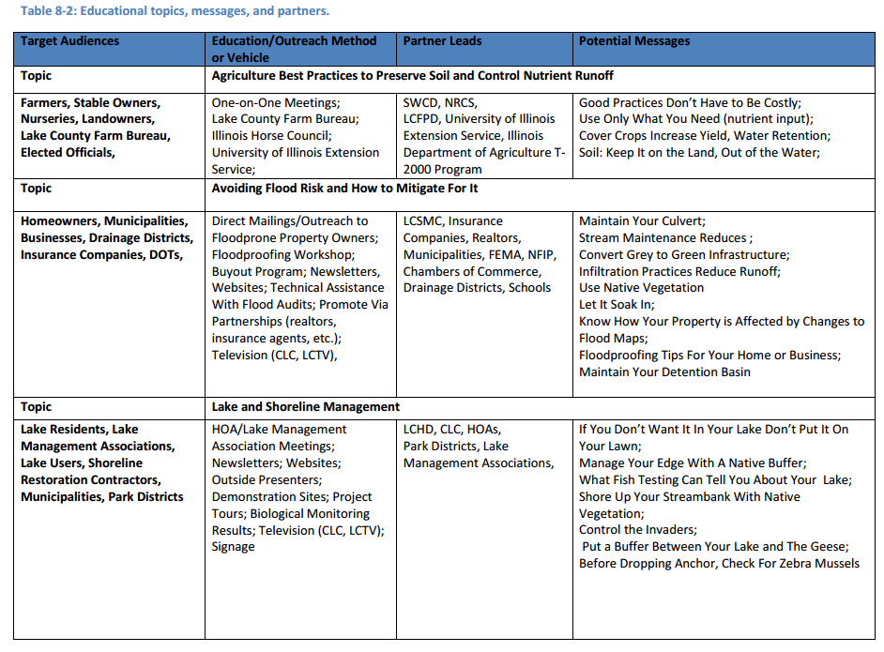
What’s in a Watershed-based Plan?
Element 5 – continued.

Slide 36
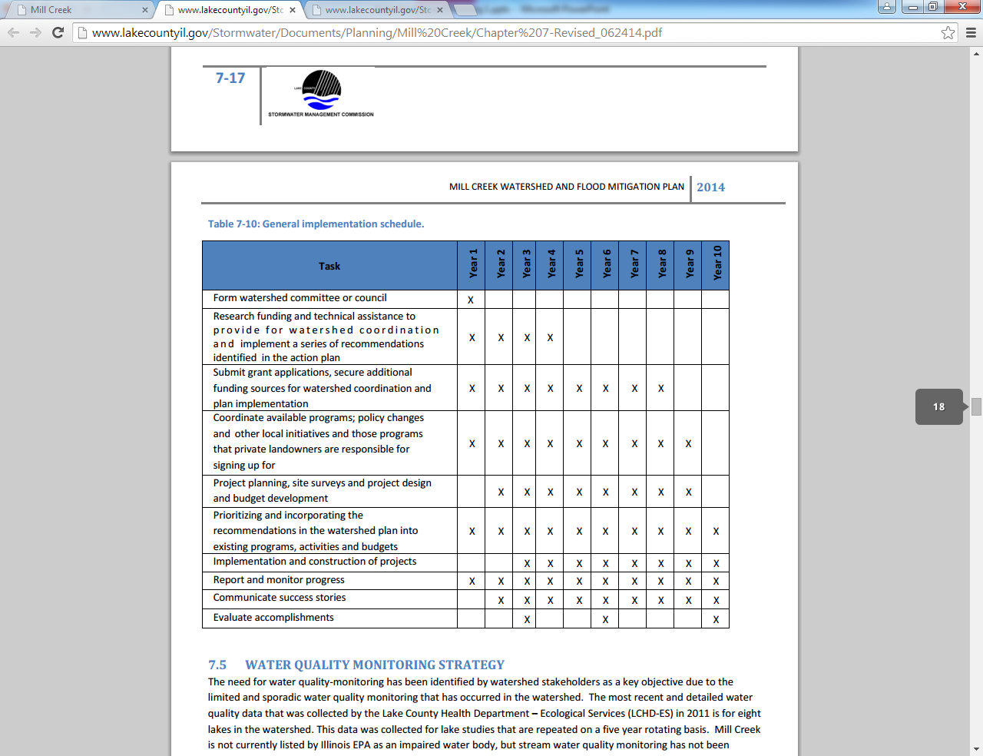

What’s in a Watershed-based Plan?
Element 6 – Provide a schedule for implementing the management measures identified in the plan.
The watershed-based plan should identify a schedule for implementing:
The recommended best management practices (BMPs),
The information and education component, and
The monitoring component.

Slide 37
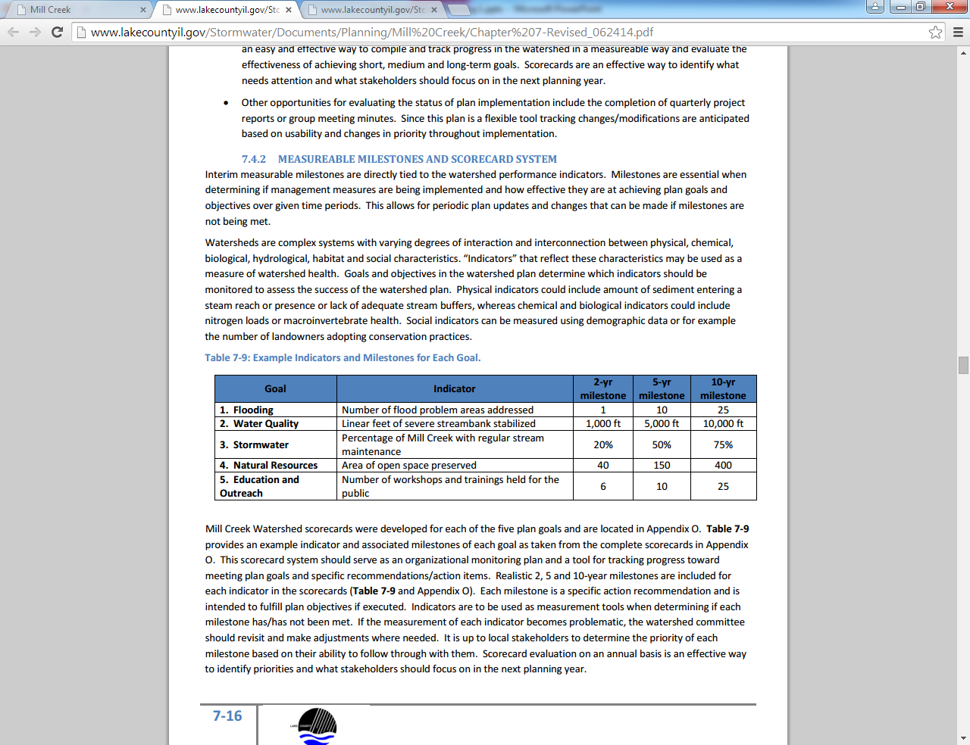
What’s in a Watershed-based Plan?
Element 7 – Interim, measurable milestones to determine if management measures are being implemented on schedule.
Identify administrative, social, and programmatic indicators that:
Can be easily communicated to various audiences.
Include action-related achievements that can be measured.

Slide 38
What’s in a Watershed-based Plan?
Element 8 – Interim benchmarks to measure progress in meeting water quality goals and load reduction targets.
Can trigger changes in the implementation approach if criteria indicate that sufficient progress is not being made.
Will provide quantitative measurements of progress made toward meeting the goals of the plan over time.
 | TSS Load Reduction Target (lbs/year) | Phosphorus Load Reduction Target (lbs/year) | Nitrogen Load Reduction Target (lbs/year) | Total Dissolved Solids (lbs/year) | BOD (lbs/year) | COD (lbs/year) | Chloride (tons/year)
2-year Milestone | 357,711 | 399 | 3,250 | 809,208 | 12,667 | 137,725 | 158
5-year Milestone | 715,422 | 798 | 6,500 | 1,618,416 | 25,333 | 275,450 | 317
7-year Milestone | 1,073,132 | 1,196 | 9,750 | 2,427,624 | 38,000 | 413,175 | 475
10-year Milestone | 1,430,843 | 1,595 | 13,000 | 3,236,832 | 50,666 | 550,900 | 633

Slide 39
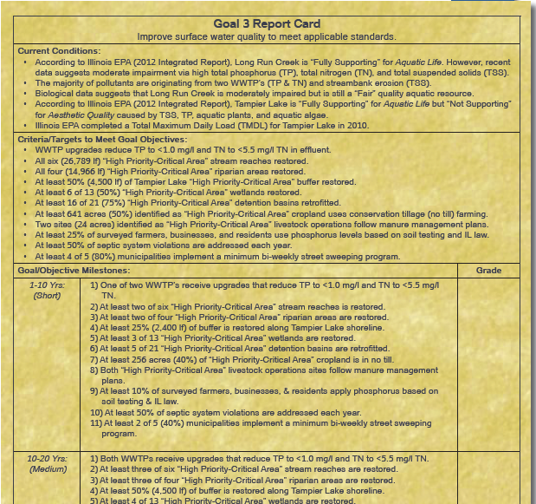

What’s in a Watershed-based Plan?
Element 8 – continued.

Slide 40



What’s in a Watershed-based Plan?
Element 9 – Describe a monitoring component.
The monitoring component recommends future assessment activities to be undertaken in the watershed and can be designed to:
Further describe existing water quality conditions.
Better identify potential causes and sources of pollution.
Target critical areas and areas needing additional study.
Assess BMP effectiveness.
Track and evaluate the effectiveness of plan implementation.
Assess environmental (i.e., physical, chemical, and biological), administrative, programmatic, and social indicators.

Slide 41

What’s in a Watershed-based Plan?
Element 9 – continued.
The milestones, benchmarks, and monitoring components support an adaptive management approach by providing mechanisms for reevaluating the implementation plan if substantial progress is not being made toward meeting watershed goals.

Slide 42

Where can you learn more?
USEPA’s Watershed Central
http://water.epa.gov/type/watersheds/datait/watershedcentral/index.cfm

Slide 43

Where can you learn more?
USEPA’s A QUICK GUIDE to Developing Watershed Plans to Restore and Protect Our Waters
http://water.epa.gov/polwaste/nps/upload/watershed_mgmnt_quick_guide.pdf

Slide 44

Where can you learn more?
USEPA’s Handbook for Developing Watershed Plans to Restore and Protect Our Waters
http://water.epa.gov/polwaste/nps/handbook_index.cfm

Slide 45

Where can you learn more?
Guidance For Developing Watershed Action Plans in Illinois
http://www.epa.state.il.us/water/watershed/publications/watershed-guidance.pdf

Slide 46




Where can you learn more?
Examples of recently approved watershed-based plans
Mill Creek Watershed and Flood Mitigation Plan
http://www.lakecountyil.gov/Stormwater/LakeCountyWatersheds/DesPlainesRiver/Pages/MillCreek.aspx
9 Lakes Watershed-based Plan
http://www.foxriverecosystem.org/9Lakes.htm
North Mill Creek-Dutch Gap Canal Watershed-Based Plan
http://www.lakecountyil.gov/Stormwater/LakeCountyWatersheds/DesPlainesRiver/Pages/NorthMillCreek.aspx
Long Run Creek Watershed-Based Plan
http://www.longruncreek.org/watershedplan
Spring Creek Watershed-Based Plan
http://www.lakecountyil.gov/Stormwater/LakeCountyWatersheds/SpringCreek/Pages/default.aspx

Slide 47

Scott Ristau
Illinois Environmental Protection Agency
Bureau of Water, Nonpoint Source Unit
1021 North Grand Ave. East, PO Box 19276
Springfield, Illinois 62794-9276
217-782-3362
Scott.Ristau@illinois.gov
http://www.epa.illinois.gov/topics/water-quality/watershed-management/index

