Slide 1

The Future of Science
of the Mahomet Aquifer
Presented by Jason Thomason, ISGS
March 26, 2018
with contributions from Kisa Mwakanyamale and Steve Brown, ISGS
for the Mahomet Aquifer Protection Task Force Meeting, Champaign, Illinois

Slide 2
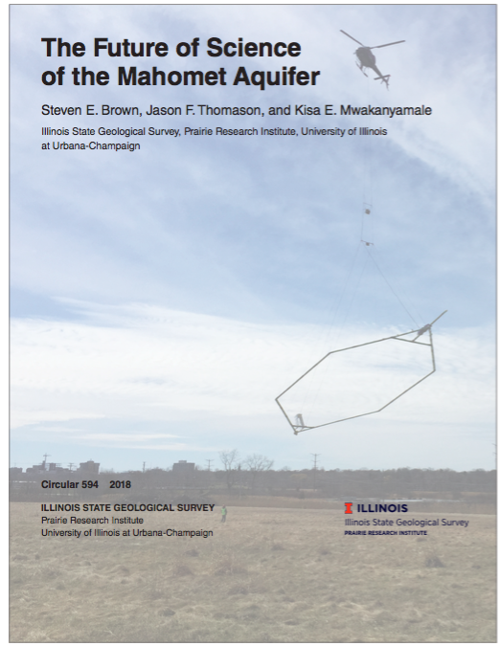


Illinois State Geological Survey (ISGS)
Publication from February, 2018
New vision of aquifer mapping at ISGS
Kisa Mwakanyamale
Geophysicist, ISGS
Steve Brown
Chief Scientist, ISGS

Slide 3
Why a new vision?
Mahomet Aquifer Workshop- June 2017- UIUC
Summary
  Identify/Revisit Stakeholder Needs
    Water Quantity “How much?”
    Recharge “Where does it happen?”
    Water Quality “How do we protect it?”
  Science Research
    New geologic mapping strategies-ISGS
    New groundwater modeling strategies-ISWS
  Communicate
    Direct public engagement
    Accessibility to information
    Effective formats and tools
    Information exchange community
Information threshold
Innovate

Slide 4
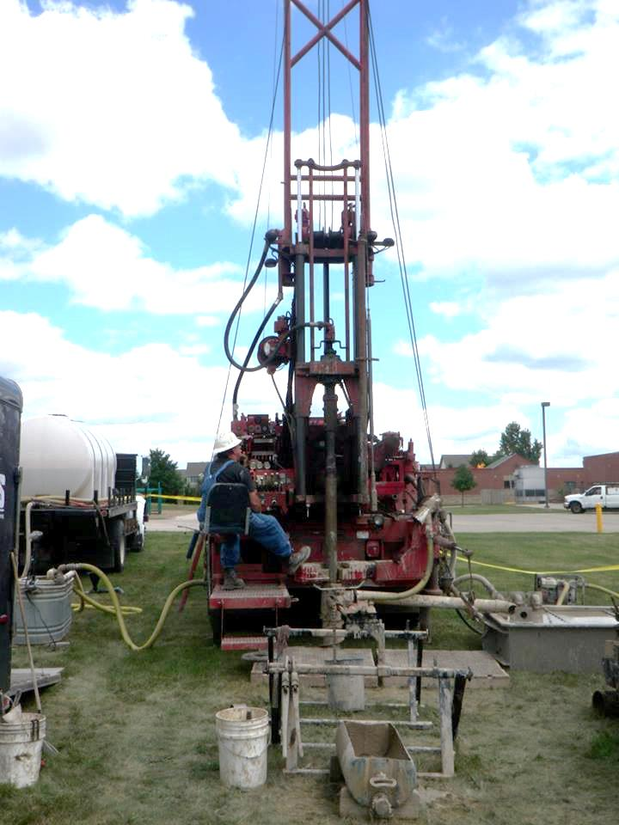
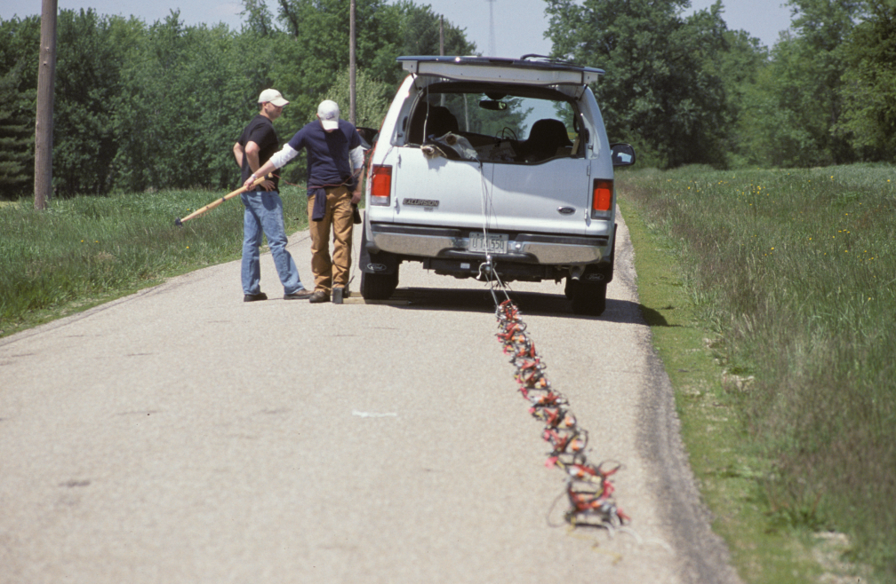
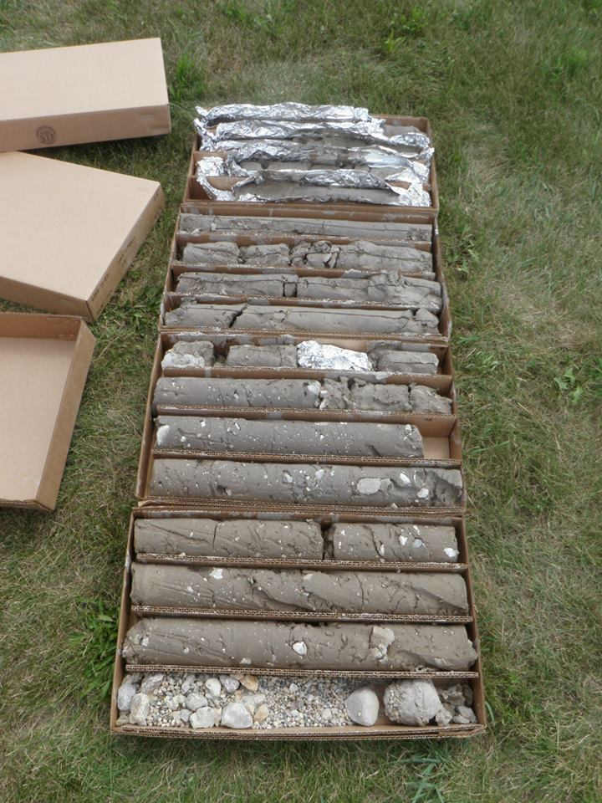
How do we map aquifers?
  Traditional Methods
    Drilling/historical records
    Sample analyses
    1-D, 2-D geophysical imaging (ground-based)
    Cross-section interpretation
    Single county-scale 3-D mapping…4-5 years
Non-aquifer material
Aquifer material

Slide 5
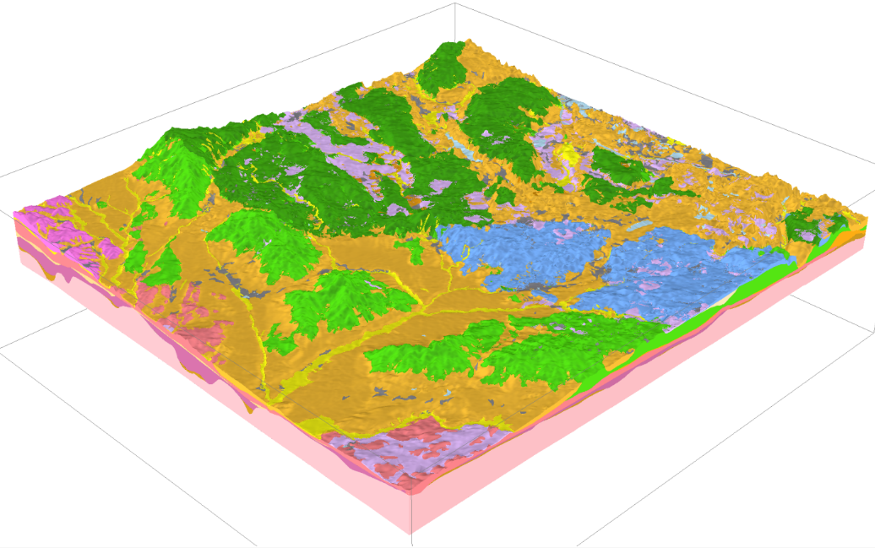
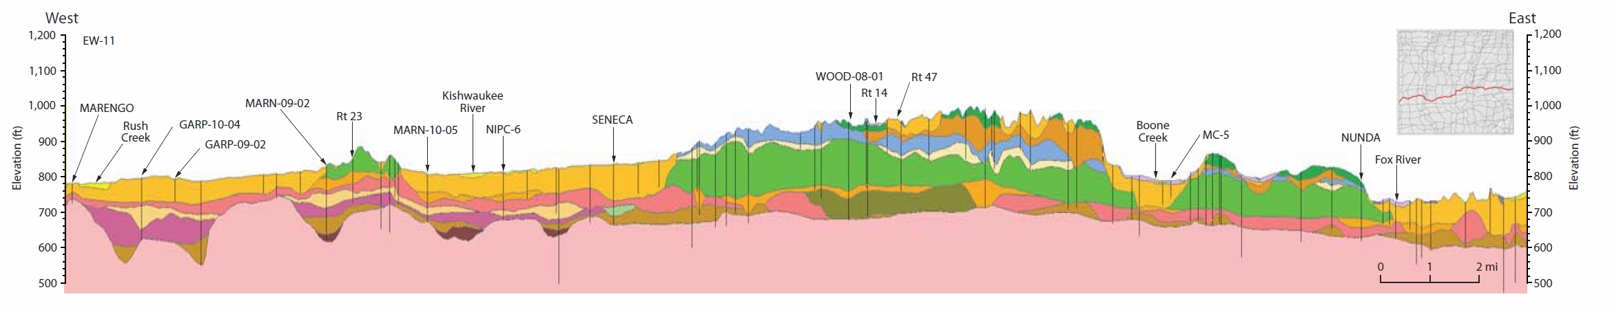
How do we map aquifers?
  Traditional Methods
    Drilling/historical records
    Sample analyses
    1-D, 2-D geophysical imaging (ground-based)
    Cross-section interpretation
    Single county-scale 3-D mapping…4-5 years

Slide 6
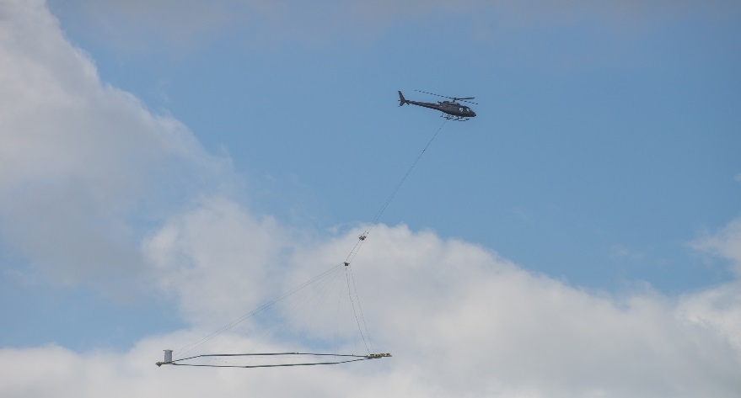

How do we map aquifers?
  Traditional Methods
    Drilling/historical records
    Sample analyses
    1-D, 2-D geophysical imaging (ground-based)
    Cross-section interpretation
    Single county-scale 3-D mapping…4-5 years
  New Methods
    Airborne geophysics: Helicopter-based Transient Electromagnetics (HTEM)
    Efficient/targeted ground-based geophysics
    3D visualization
    Single county-scale 3-D mapping…months?

Slide 7
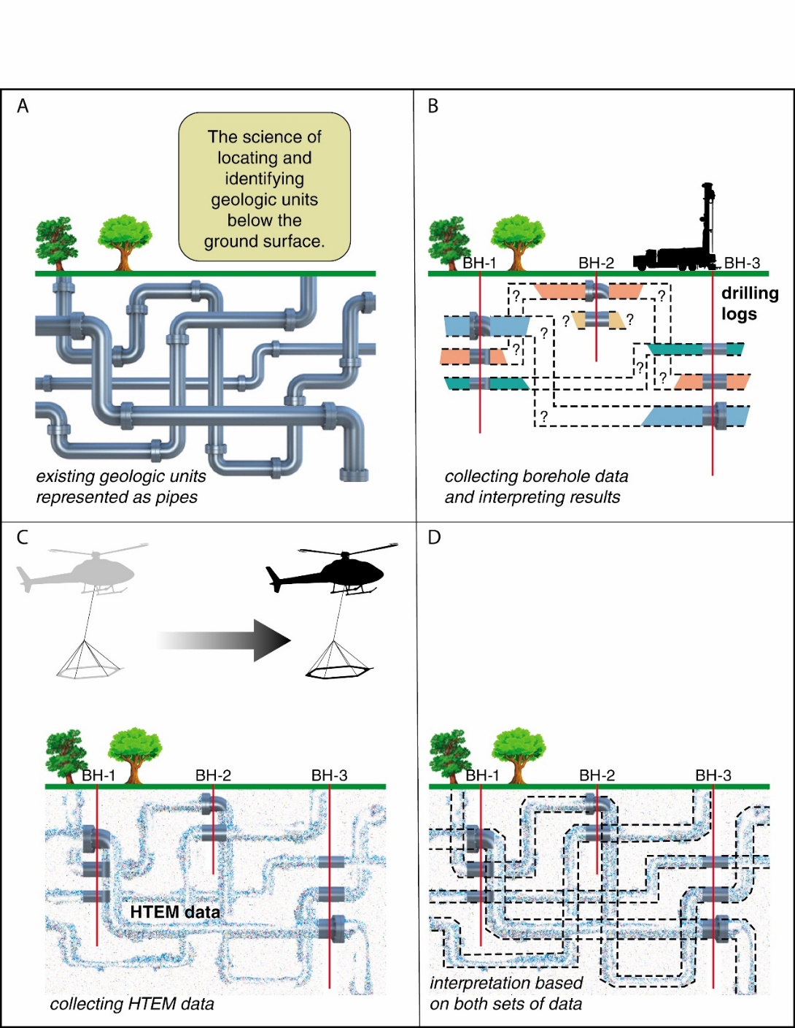
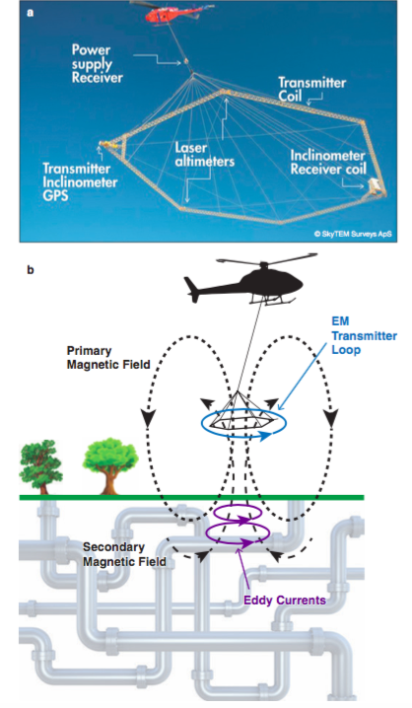
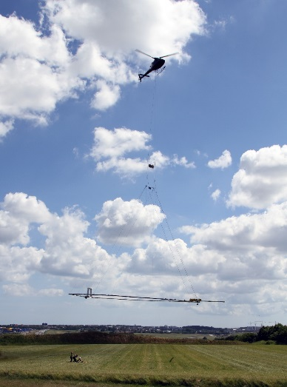
Transient Electromagnetics - TEM
Airborne Profiling Tool –
Helicopter TEM (HTEM)
  Deep penetration: ≤ 600 m (1968 ft)
  High resolution for county/regional scale
  Rapid/dense data coverage
  Cost: approximately $100/line km + $19,000 mobilization fee
  + Processing software fee
Fill gaps between boreholes
Flight line
map

Slide 8
HTEM : Denmark Example
Borehole vs HTEM Survey
Borehole Mapping
HTEM mapping
DENSER DATA COVERAGE than traditional borehole surveys, resulting in higher resolution maps

Slide 9
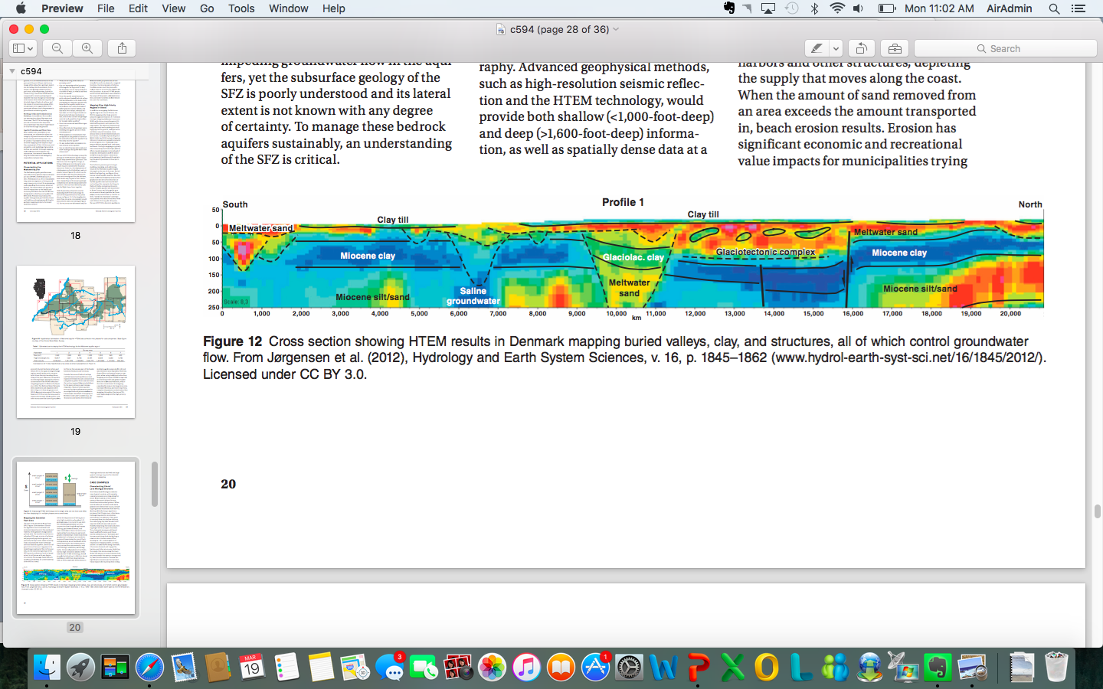
HTEM Examples
Aquifer Mapping – Denmark
Jørgensen et al. 2012
Aquifer Mapping – Nebraska (USGS)

Slide 10
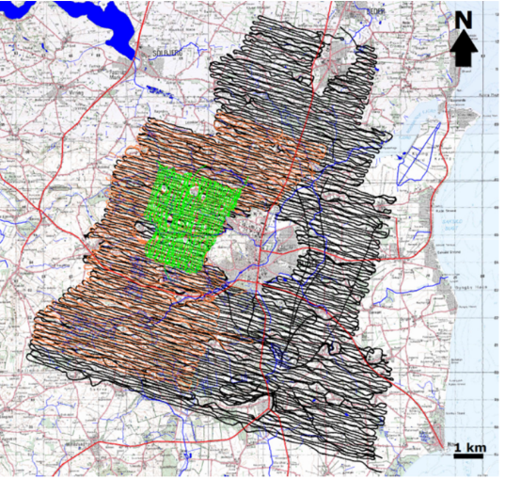
HTEM : Speed and Cost, Denmark Example
Phase 1: Black lines
100 m line spacing
1203 km ~ 13h 26m
Phase 2: Orange lines
50 m line spacing
465 km ~ 5h 06m
1118 miles in one week
Phase 3: Green lines
50 m line spacing
178 km ~ 1h 59m
Example from Denmark
Data collection: 1118 line mi - ~ $184,600
Mobilization: $19,000
Processing software: $12,922
Delivery time: ≤ 1 month
Total ~ $216,000

Slide 11
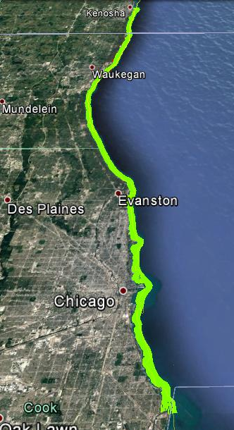
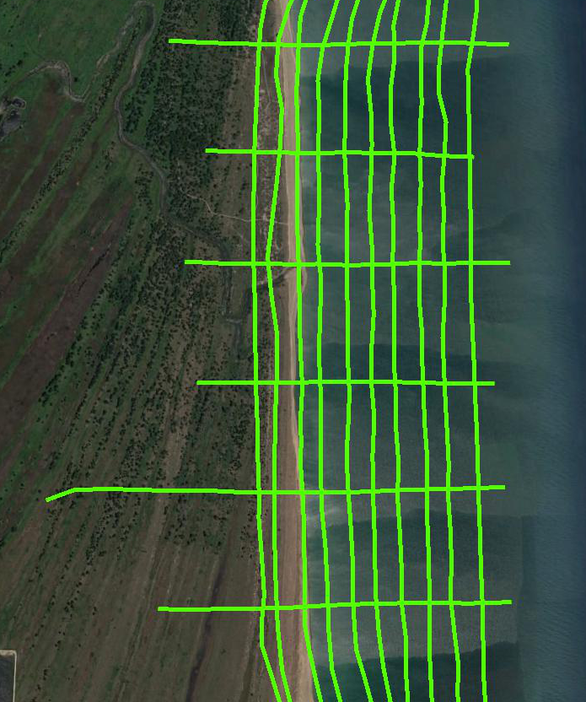
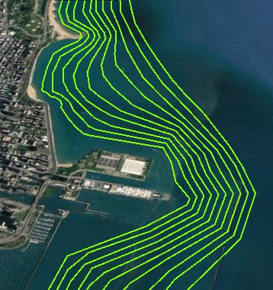
HTEM : Speed and Cost, Lake Michigan Example
WISCONSIN
ISBP
ILLINOIS
Chicago
640 mi in 3 days
Data collection: 640 line mi - ~ $170,000
Mobilization: $19,000
Delivery time: months
Total ~ $190,000
INDIANA

Slide 12
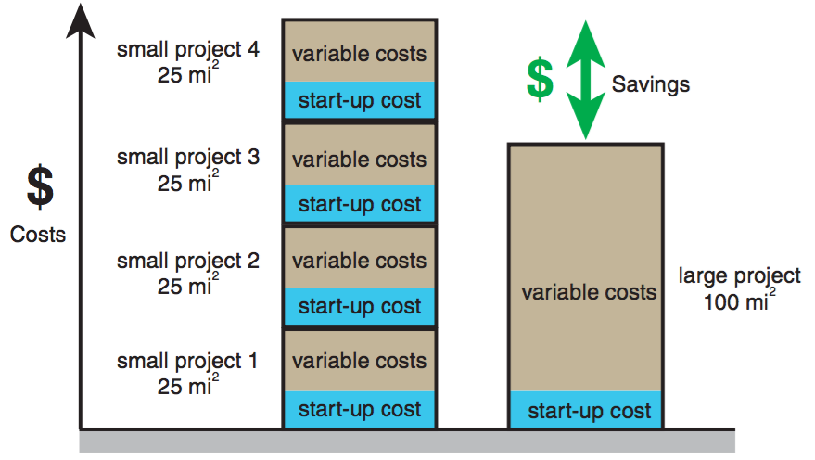
Relative Cost Model
Previous project estimates/costs
25-35 mi²= ~$100,000-120,000 (Southern IL)
45 mi²= ~$190,000 (Lake Michigan Coast, IL)
~80 mi²= ~$216,000 (Denmark near Arhus)

Slide 13
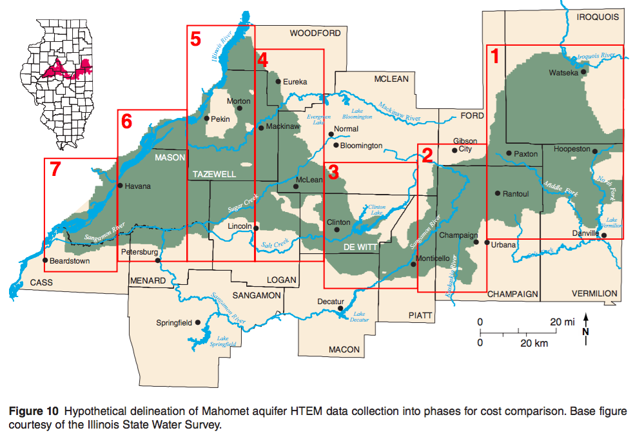
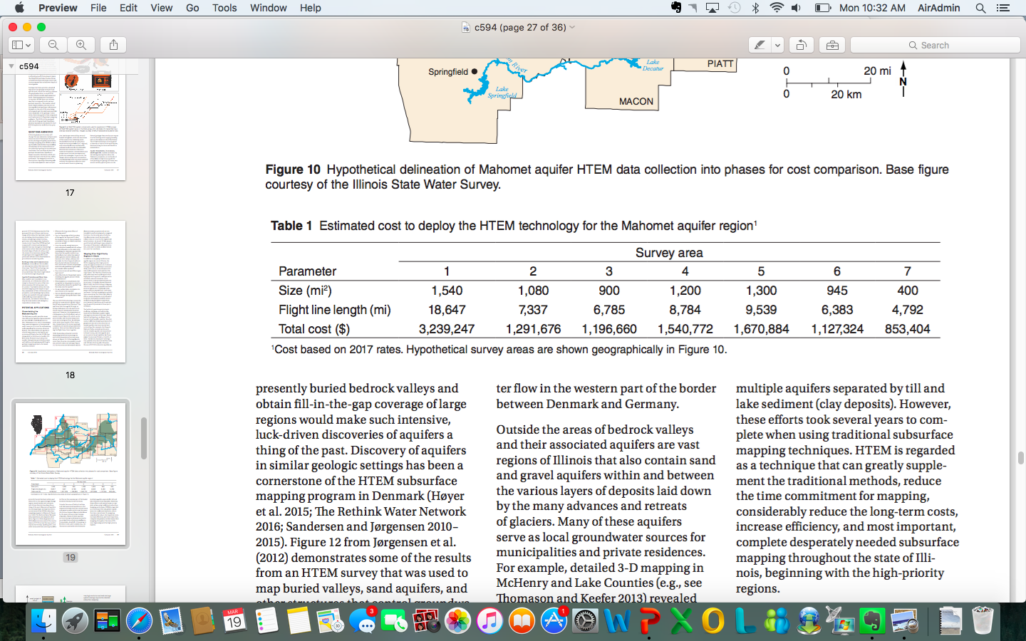
Mahomet Aquifer Cost Estimate Example

Slide 14
Summary of Mapping Vision with HTEM
Benefits
  High density, rapid data acquisition
  Immediate recognition of new geologic dimensions/framework
  Improve bedrock surface elevation maps/discover new information
Limitations
  FAA limitations (roads, buildings, humans)
  Electrical disturbances (city centers, power lines)
Objectives
  Move beyond information thresholds
  Fill in information gaps, “connect the dots”
  Integrate into groundwater modeling strategies
  Focus priorities
  Greatly increase confidence in decision making

Slide 15
  Contact information
Kisa Mwakanyamale
  Geophysicist, ISGS
  kemwaks@illinois.edu
Jason Thomason
  Geologist, ISGS
  jthomaso@illinois.edu
Steve Brown
  Chief Scientist, ISGS
  steebrow@illinois.edu
ISGS website
http://www.isgs.illinois.edu

